Slide 1
Internet Programming Project
Team 16:
Ali Tarek Adbelmonim 21P0123
Mohamed Mostafa Mamdouh 21P0244
Tsneam Ahmed Eliwa Zky 21P0284
Shahd Ashraf Mahmoud 2100480
Zeynat Haytham Farouk 2100588
Omar Khaled Essam 21P0178
Presented To: Eng Verena Nashaat Dr.Dina Mohamed

Slide 2

Introduction
This project leverages HTML, CSS, JavaScript, and Node.js to build a fully functional online store with:
User authentication (registration, login, and secure JWT-based sessions).
Product management (adding, updating, and browsing items).
Shopping cart & checkout (seamless order processing).
Responsive design (optimized for desktop, tablet, and mobile).
Additional features like search filters, customer reviews, promotions, and admin controls.
Our goal was to create a user-friendly, secure, and scalable E-Commerce platform while applying modern web development practices.

Slide 3
Objectives
The project aims to:
Implement core E-Commerce functionalities, including user authentication, product catalog management, shopping cart, and checkout process.
Ensure secure transactions by integrating payment gateways and order management systems.
Enhance user experience with responsive design, allowing seamless interaction across desktop, mobile, and tablet devices.
Optimize backend performance using Express.js, JWT authentication, and database encryption for security.
Encourage teamwork and individual accountability, as students must deliver the project on time and participate in oral discussions for evaluation.

Slide 4
Scope
The project covers:
User Registration & Authentication – Secure login system with JWT tokens.
Product Catalog Management – Adding, updating, and removing products with details like name, description, price, and images.
Shopping Cart & Checkout – Users can add items to their cart and complete purchases with various payment options.
Order & Inventory Management – Tracking stock levels, updating order status, and handling refunds.
Shipping & Tax Calculation – Accurate pricing based on user location.
Search & Filter Functionality – Users can easily find products using filters.Customer Reviews & Ratings – Users can leave feedback on products.
Promotions & Discounts – Implementing coupons and tracking their effectiveness.Responsive Design – Ensuring the website adapts to different screen sizes.

Slide 5
Stakeholders Involved and Their Roles in the E-Commerce Project
Users (General Customers)
Regular Users – Customers who browse products, add items to their carts, complete purchases, and leave reviews.
Authenticated Users – Registered customers who can access additional features like order history, profile management, and personalized recommendations.
Admins (Project Developers & Managers)
Site Administrator – Manages product catalog, updates inventory, reviews orders, and resolves customer issues.
System Developer – Ensures smooth functionality by handling authentication, database management, and API integration.
Project Evaluators (Instructors) – Assess the website based on security, usability, and implementation of essential features.
External Service Providers – APIs for payment processing, shipping calculations, and third-party authentication that enhance system capabilities.

Slide 6
Topic One
Login/Signup Page

Slide 7
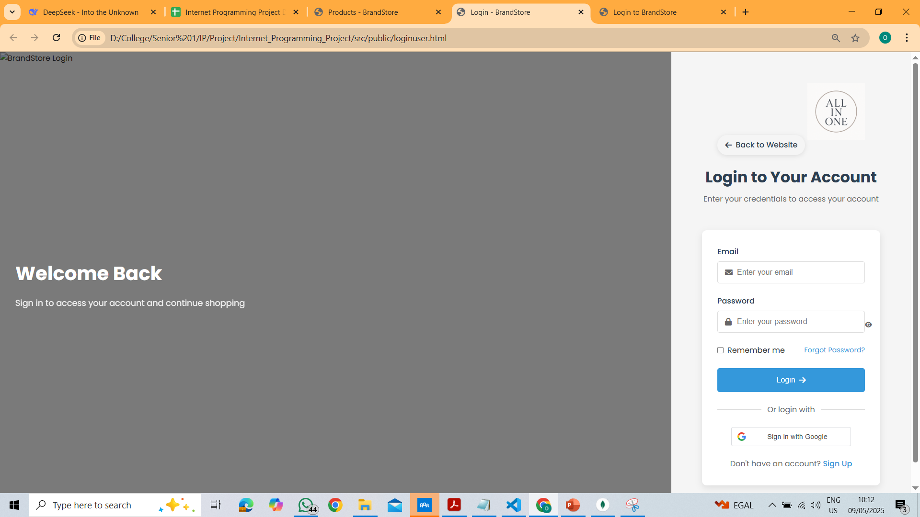
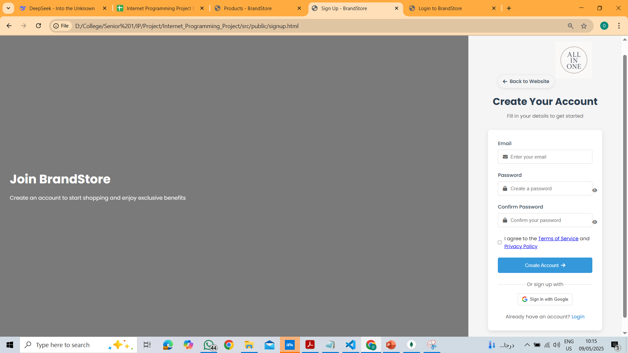
Login/Signup Page

Slide 8
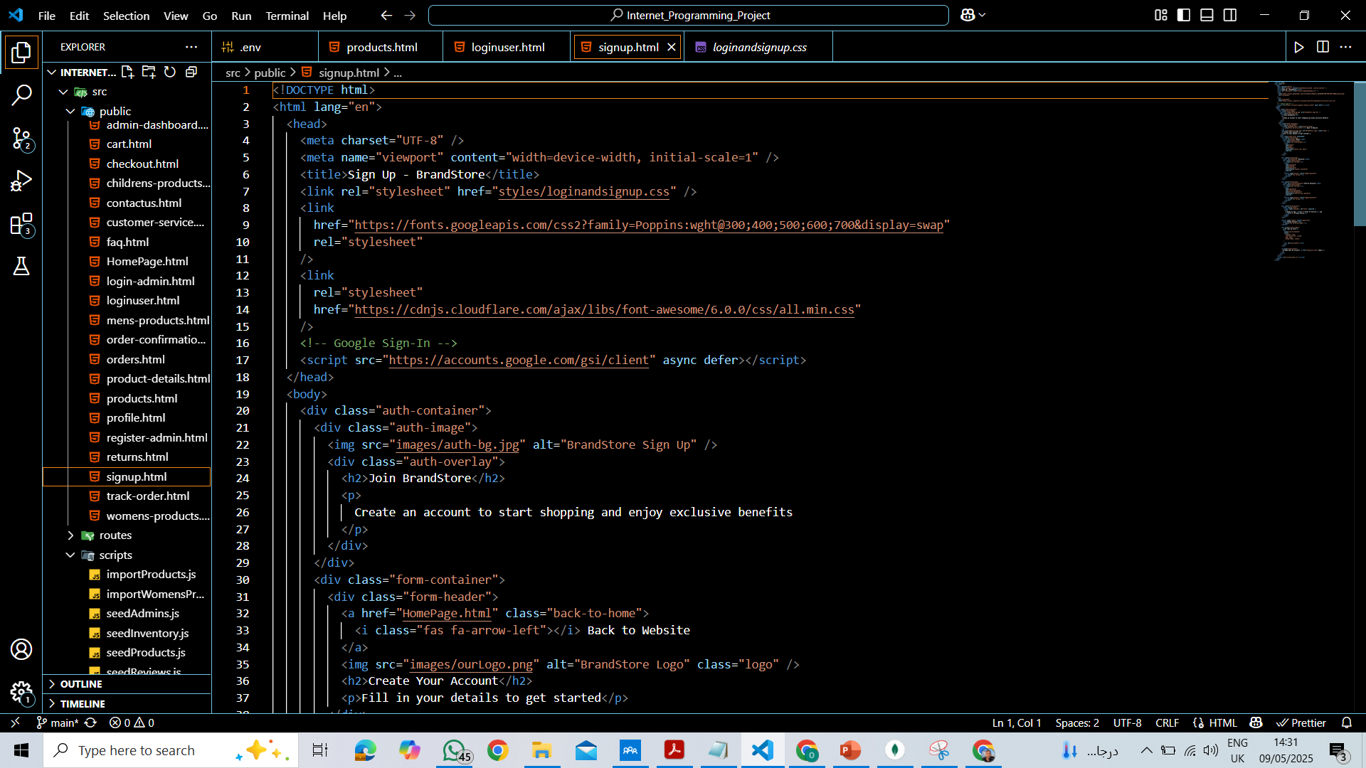
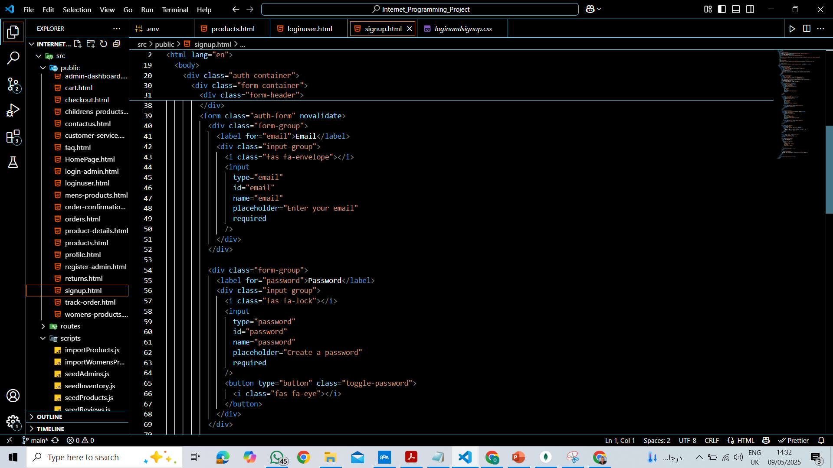
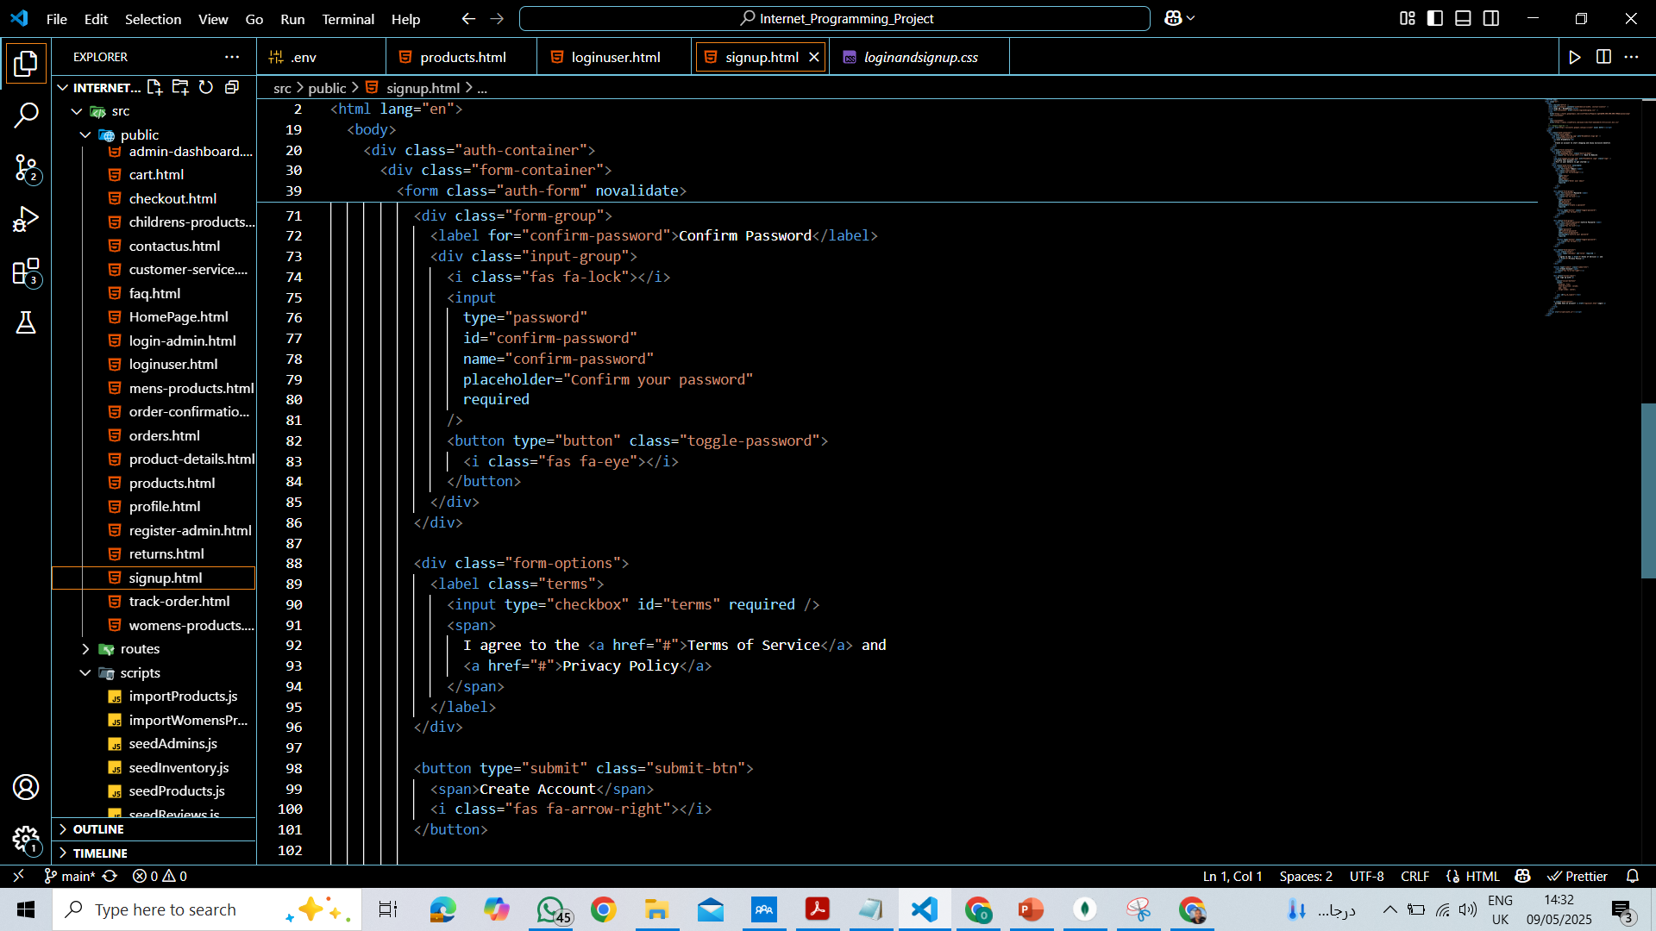
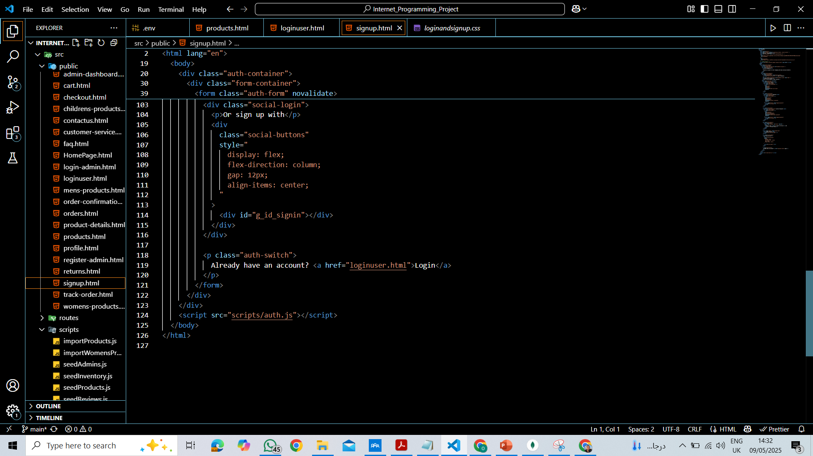
HTML for Signup

Slide 9
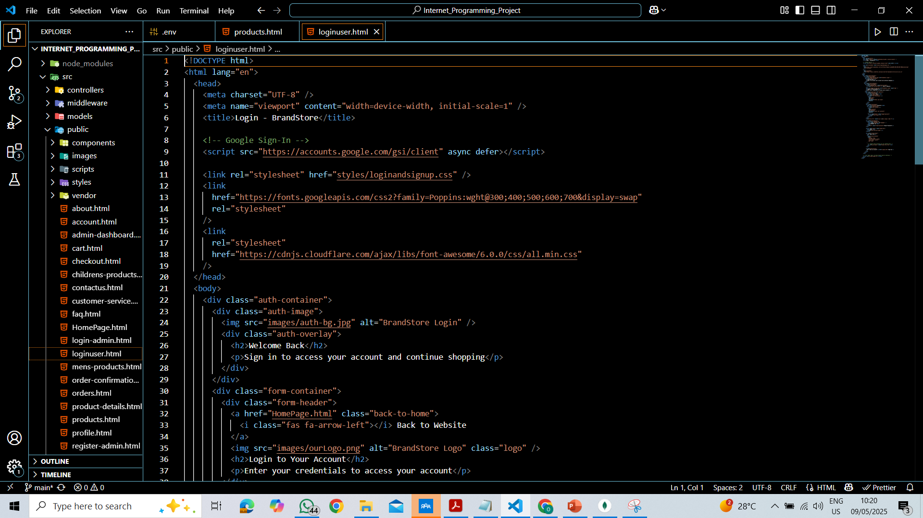
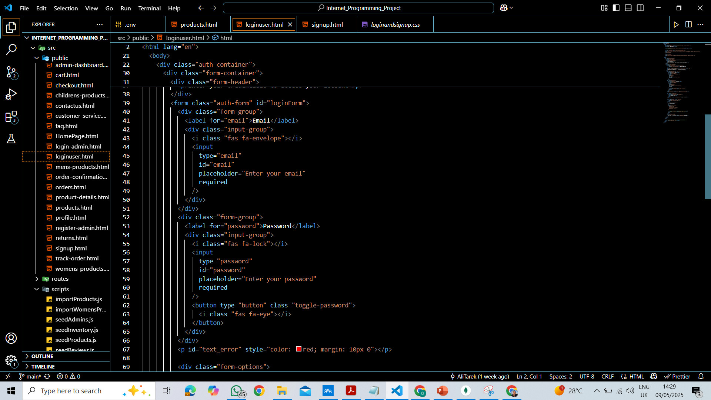
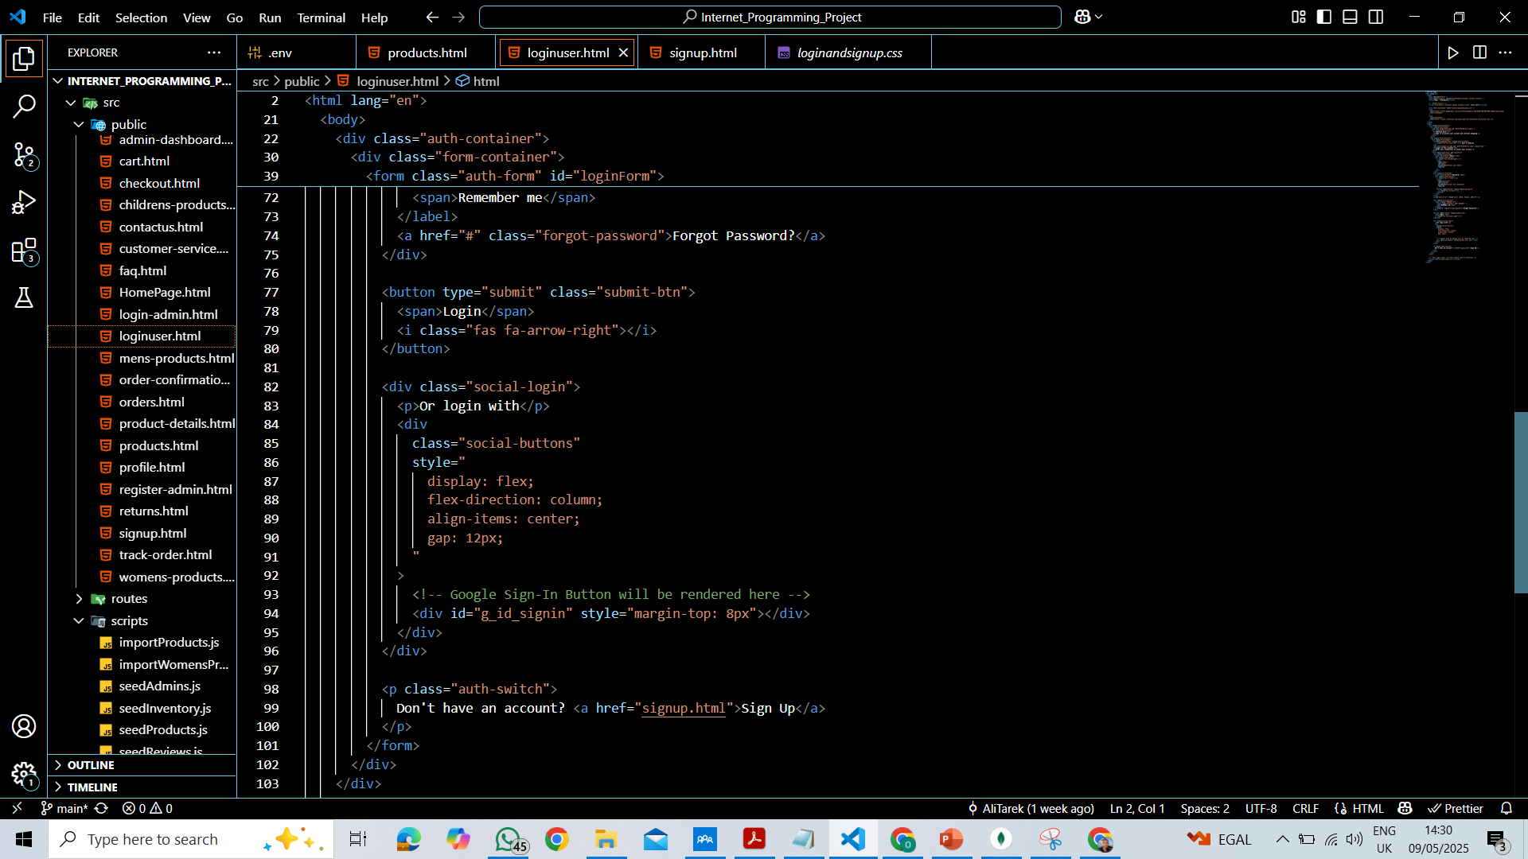
HTML for Login

Slide 10
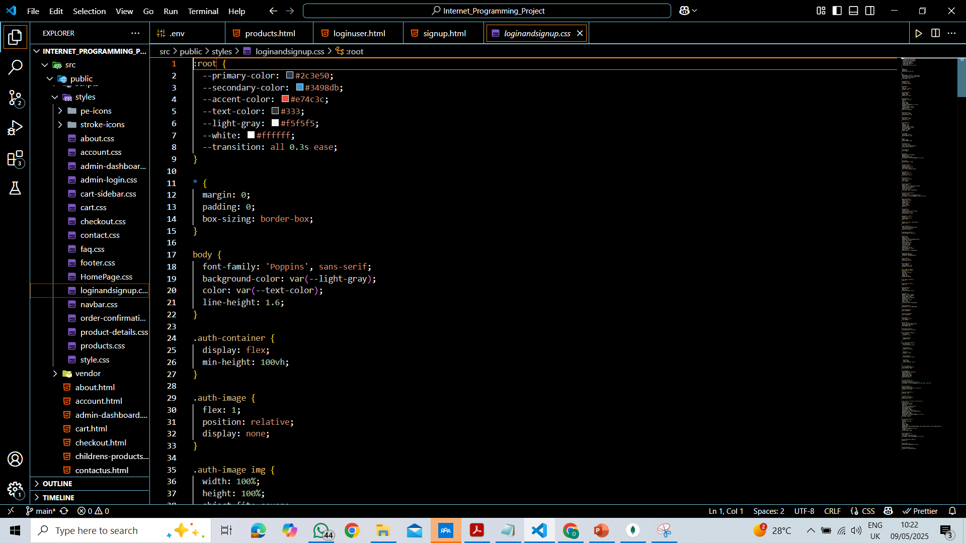
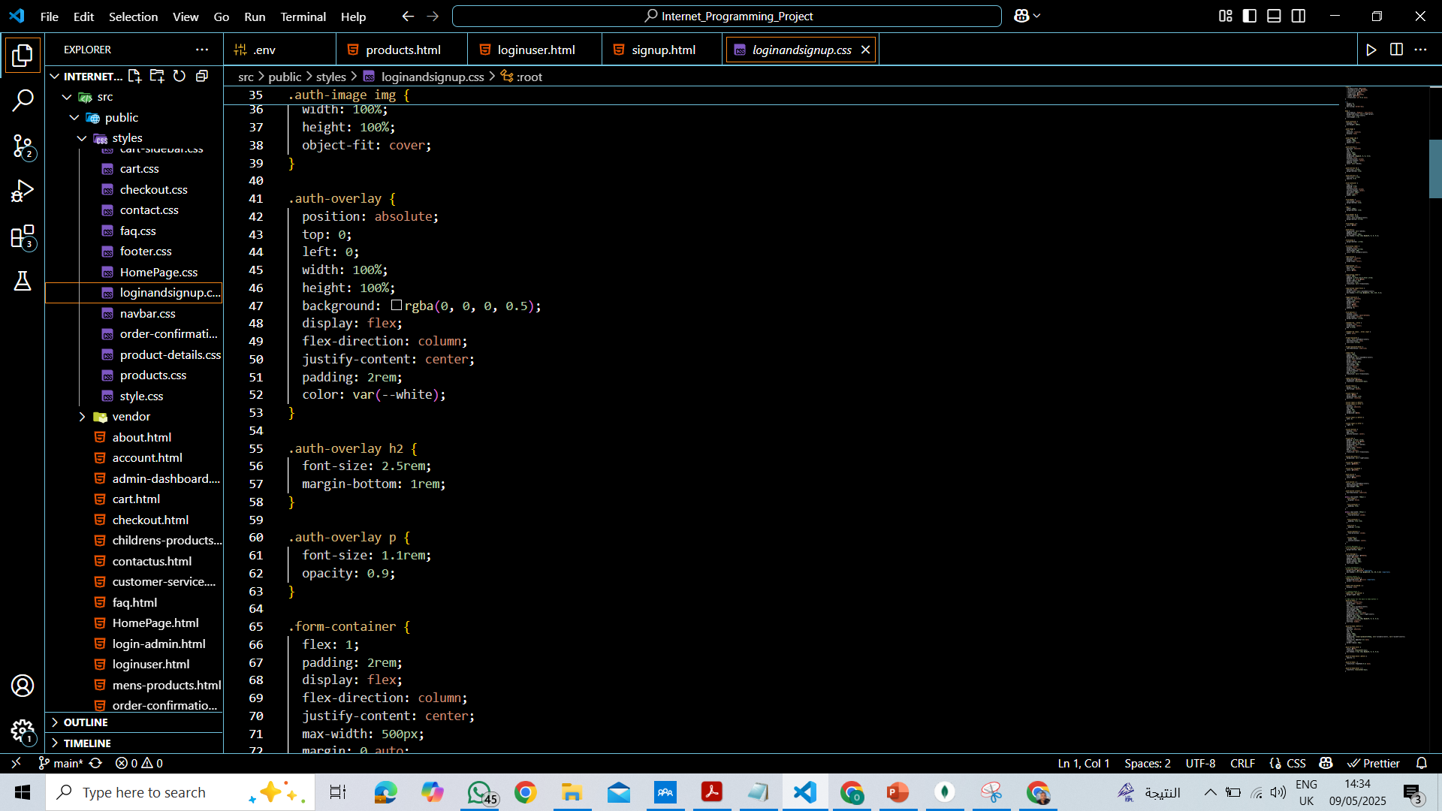
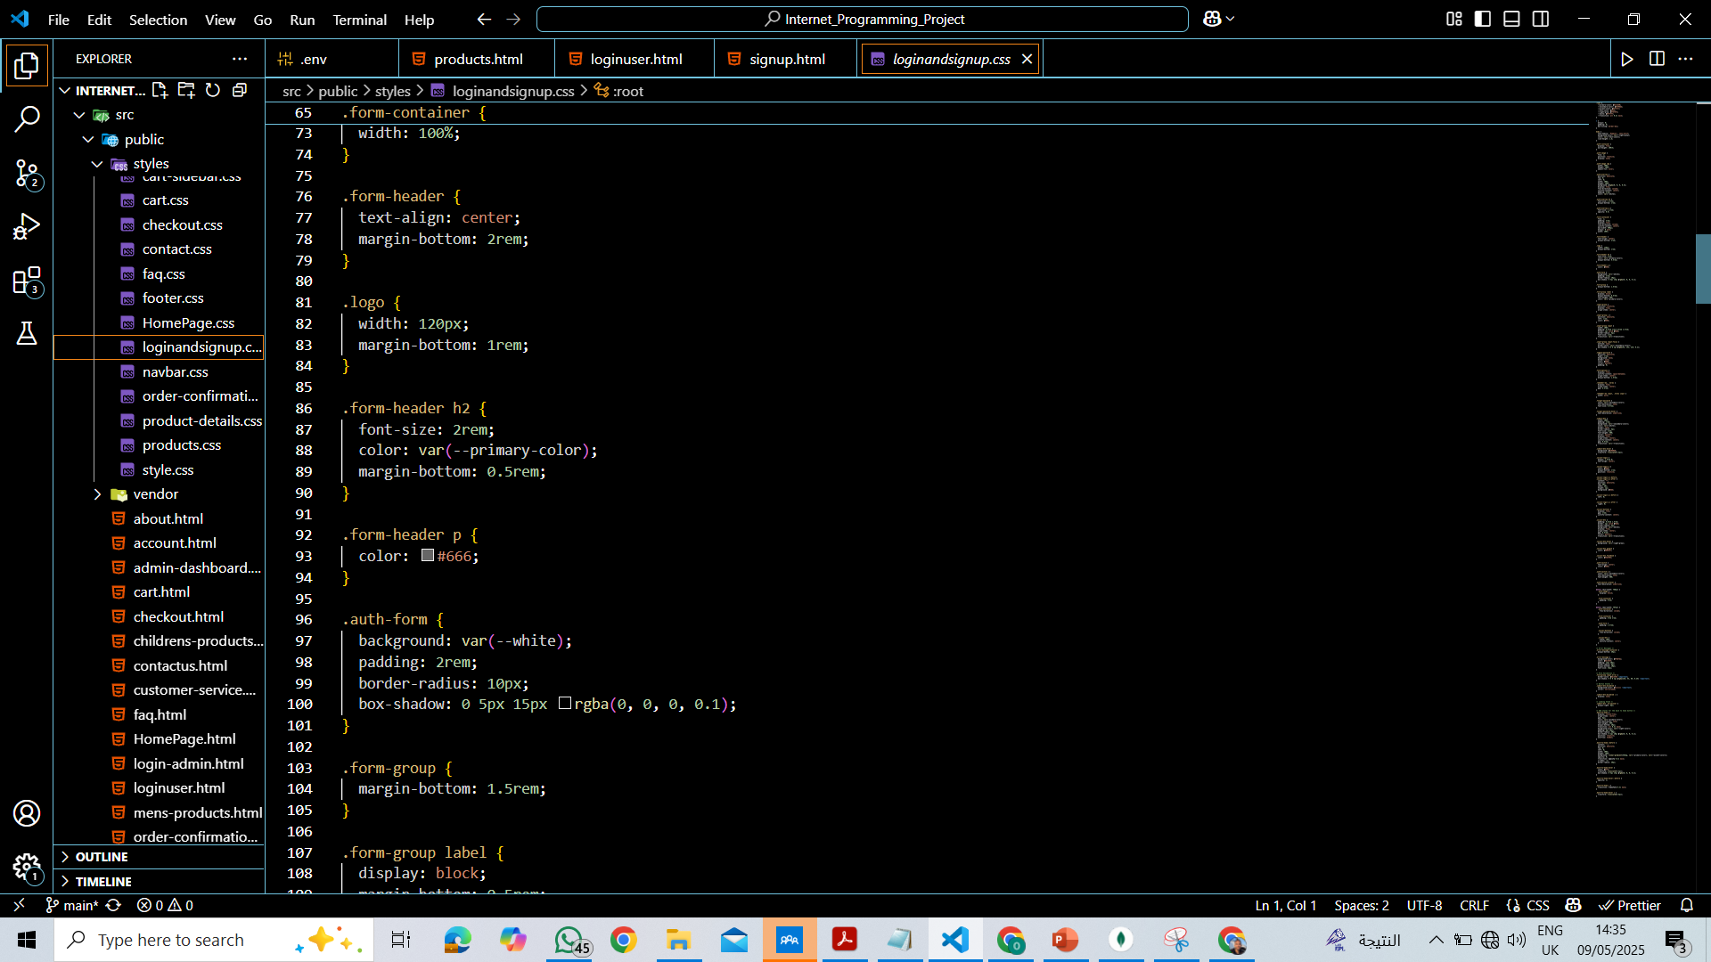
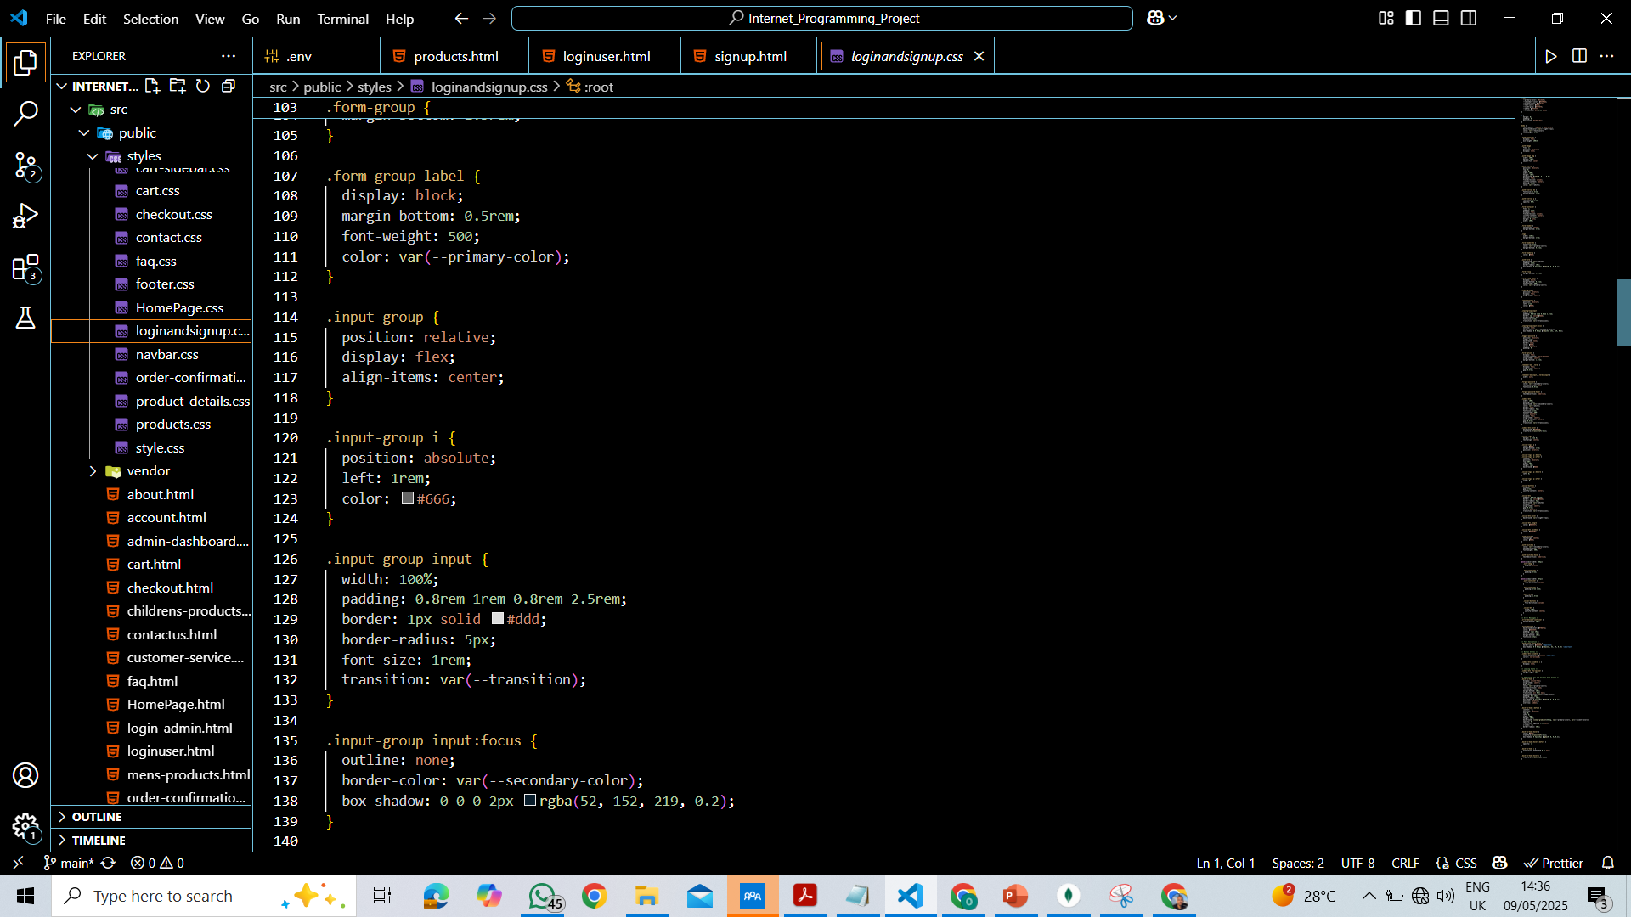
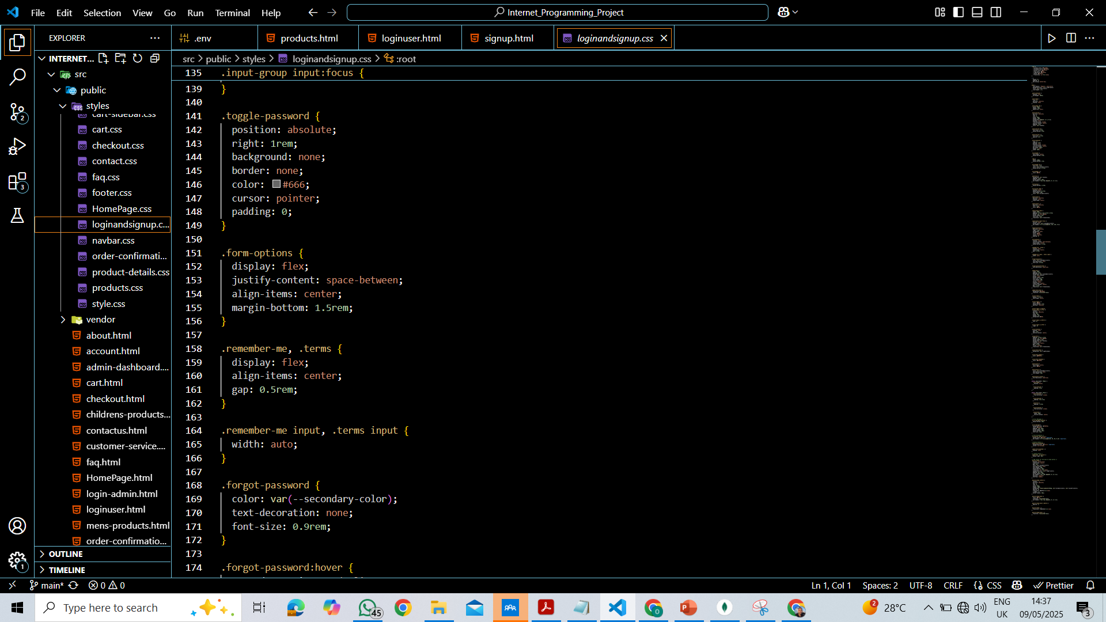
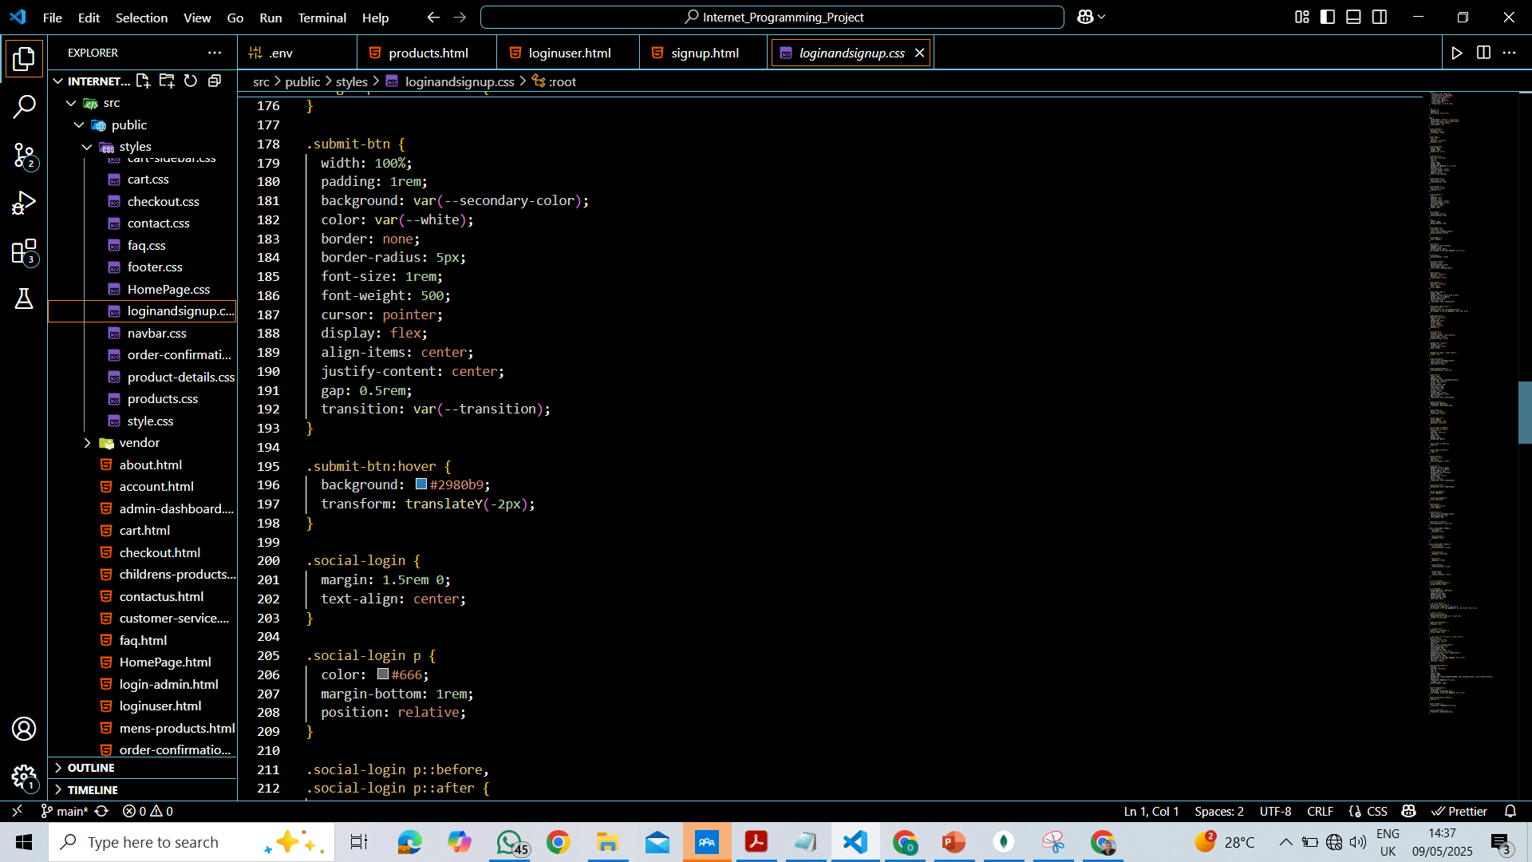
CSS for Login/Signup Pages

Slide 11
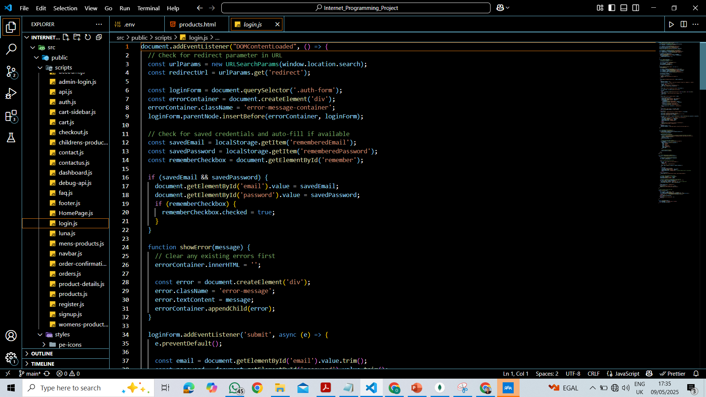
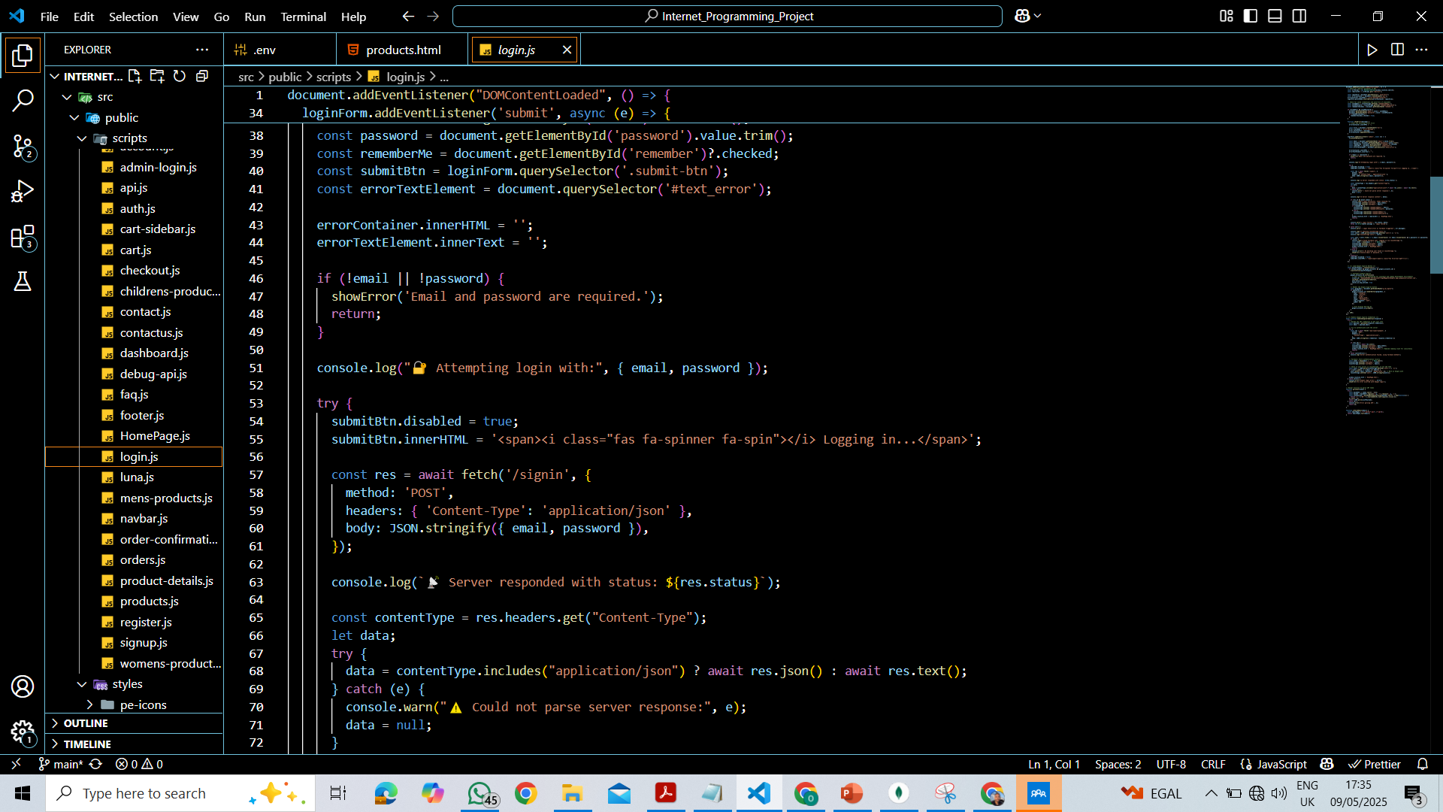
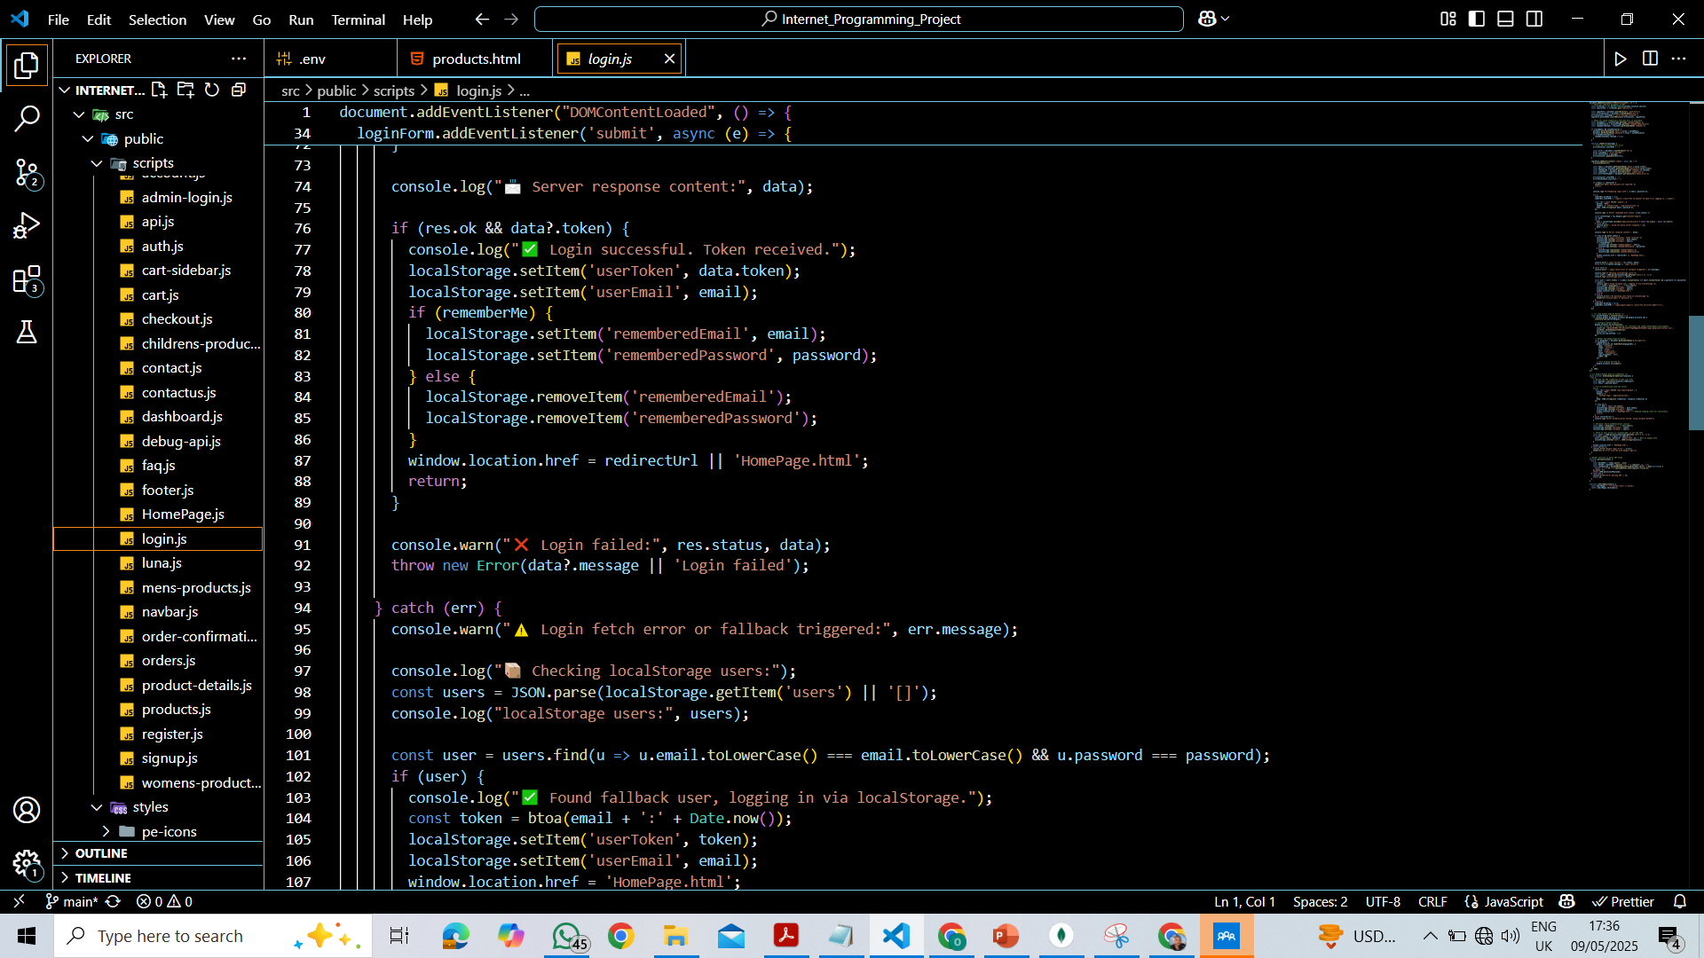
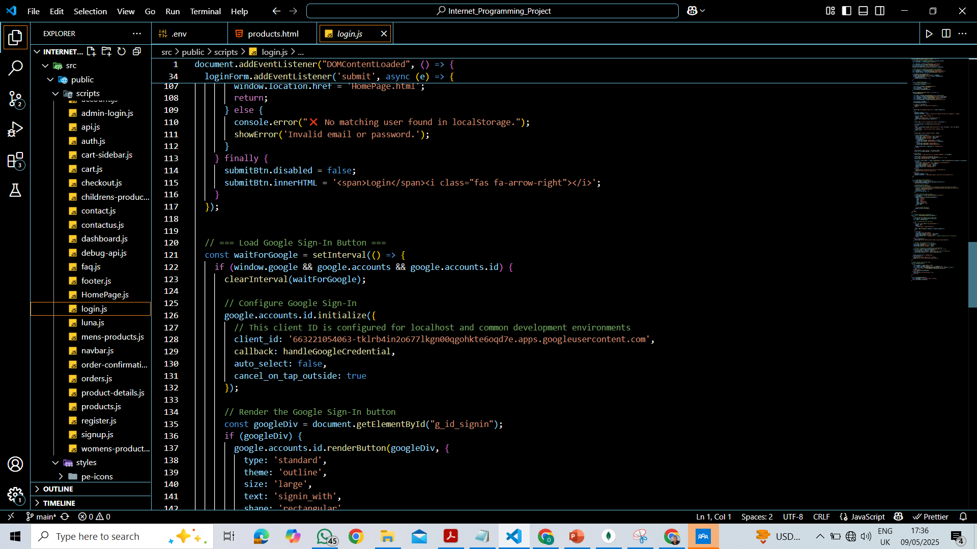
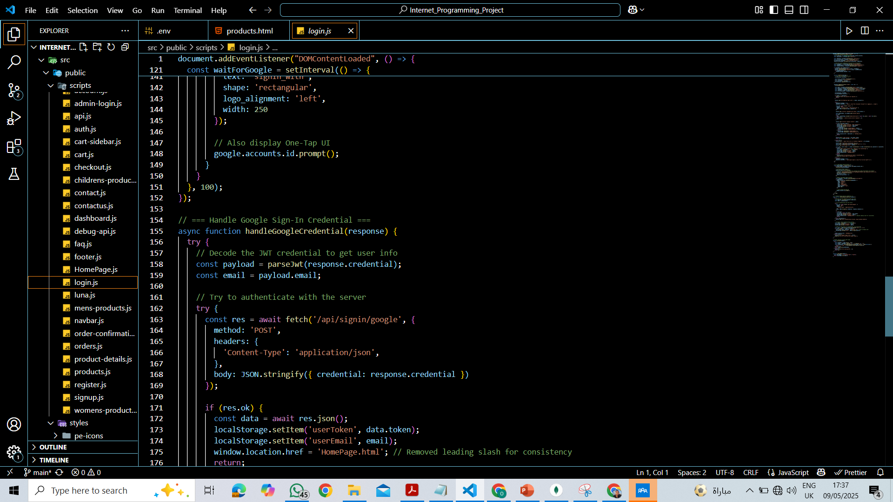
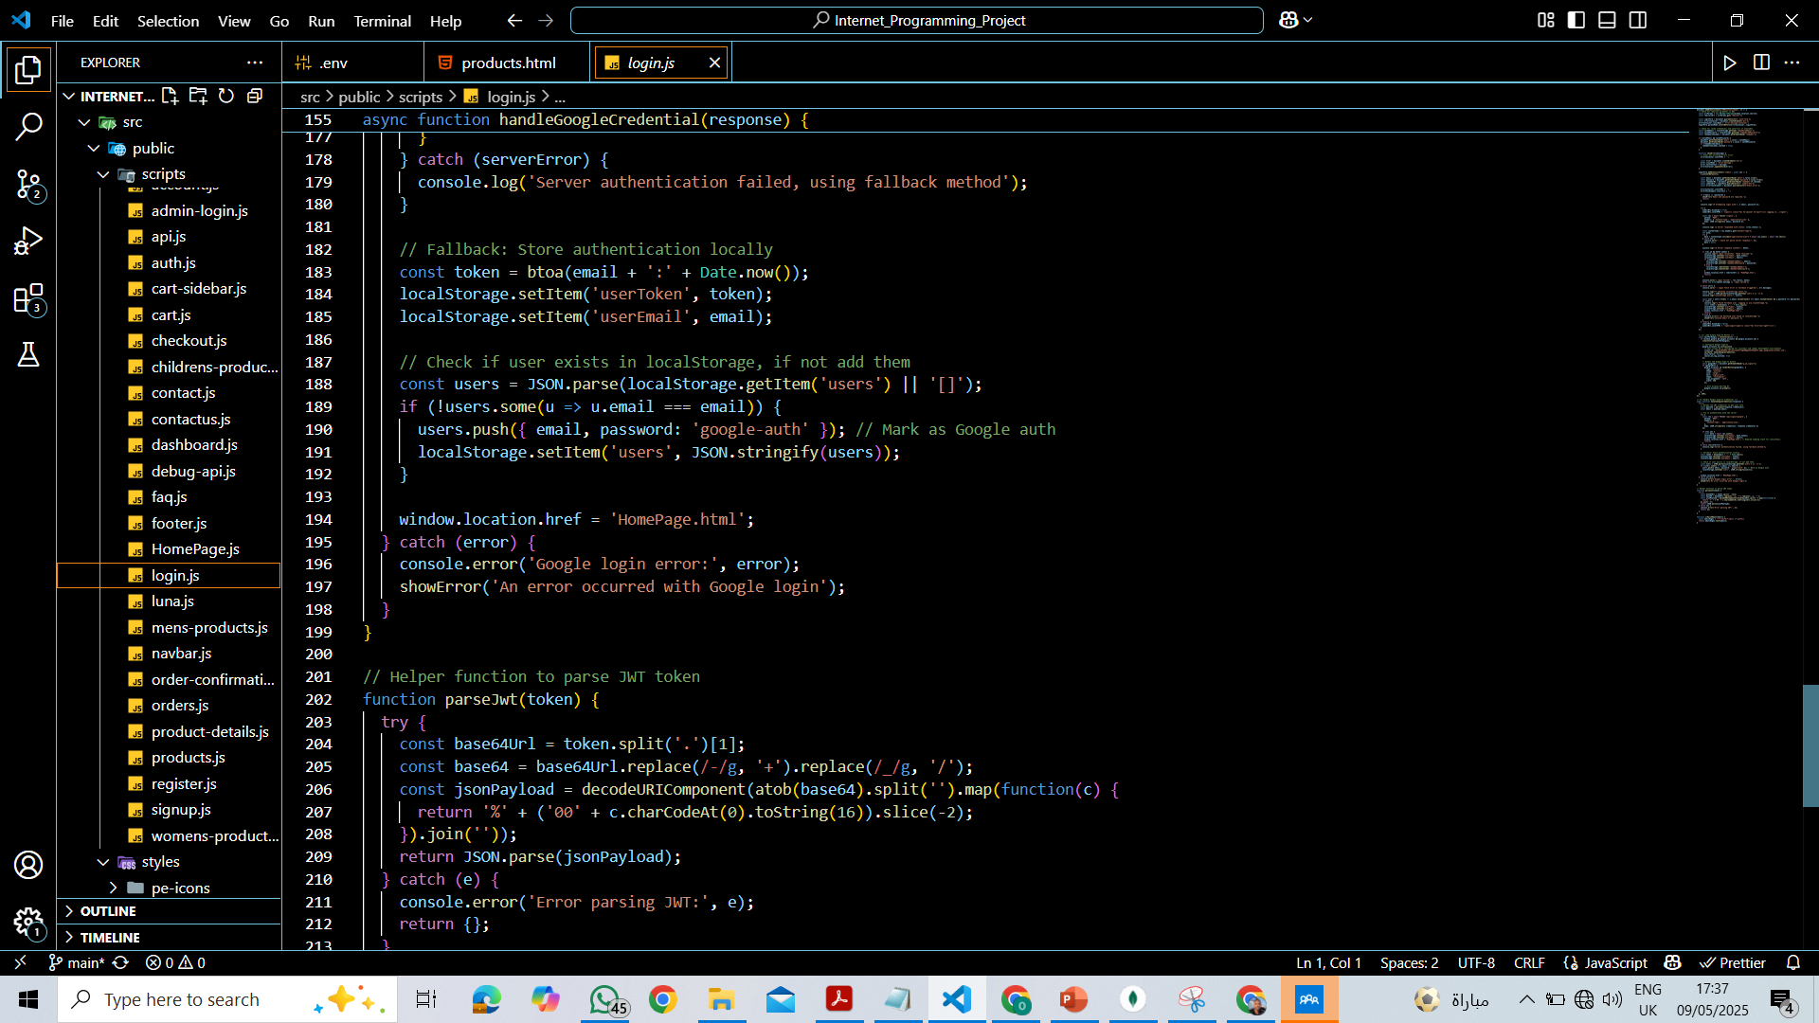
JS for Login

Slide 12
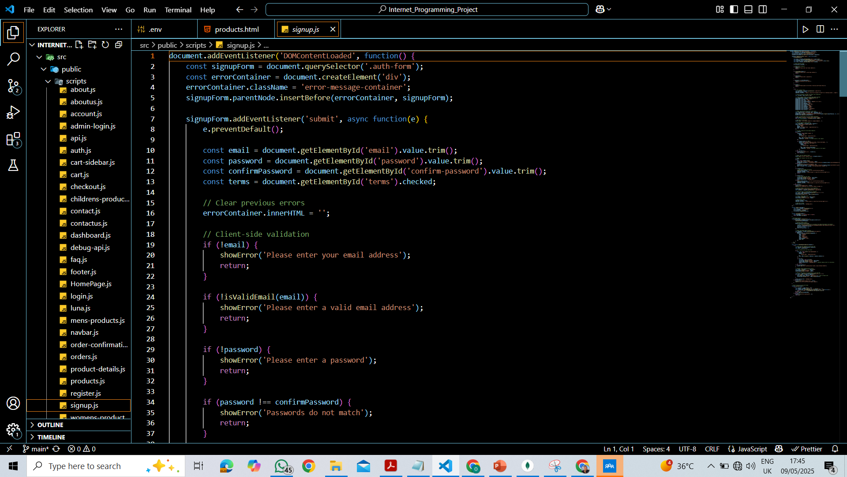
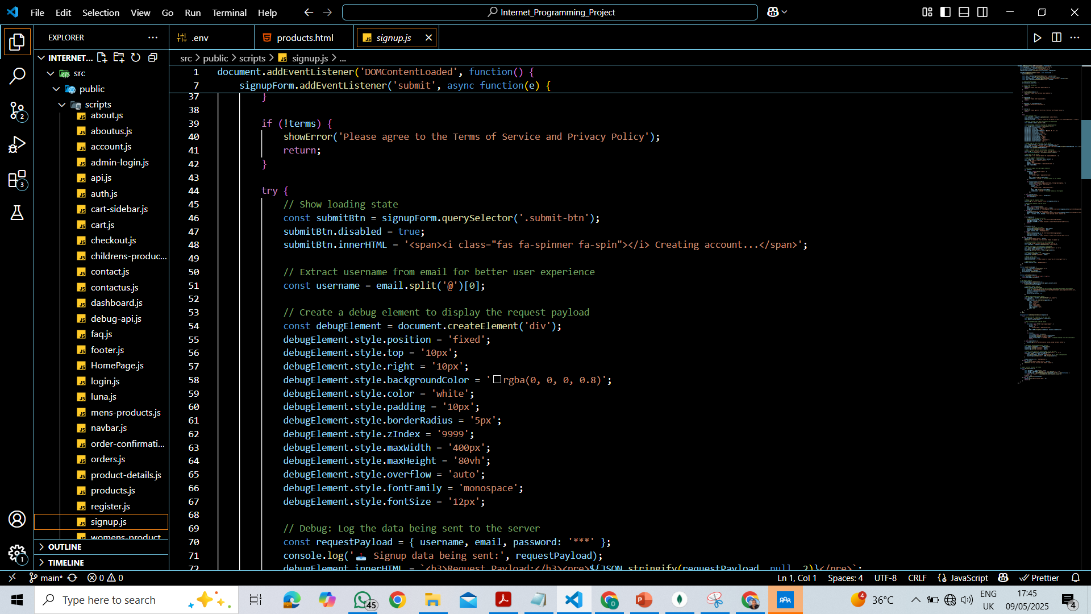
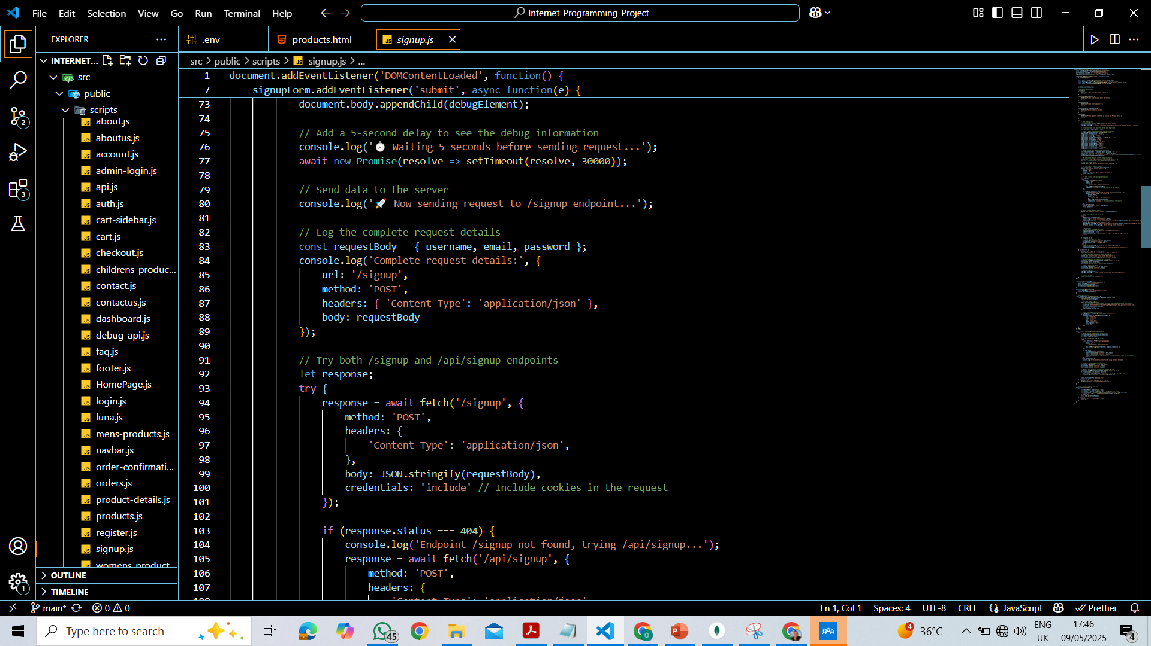
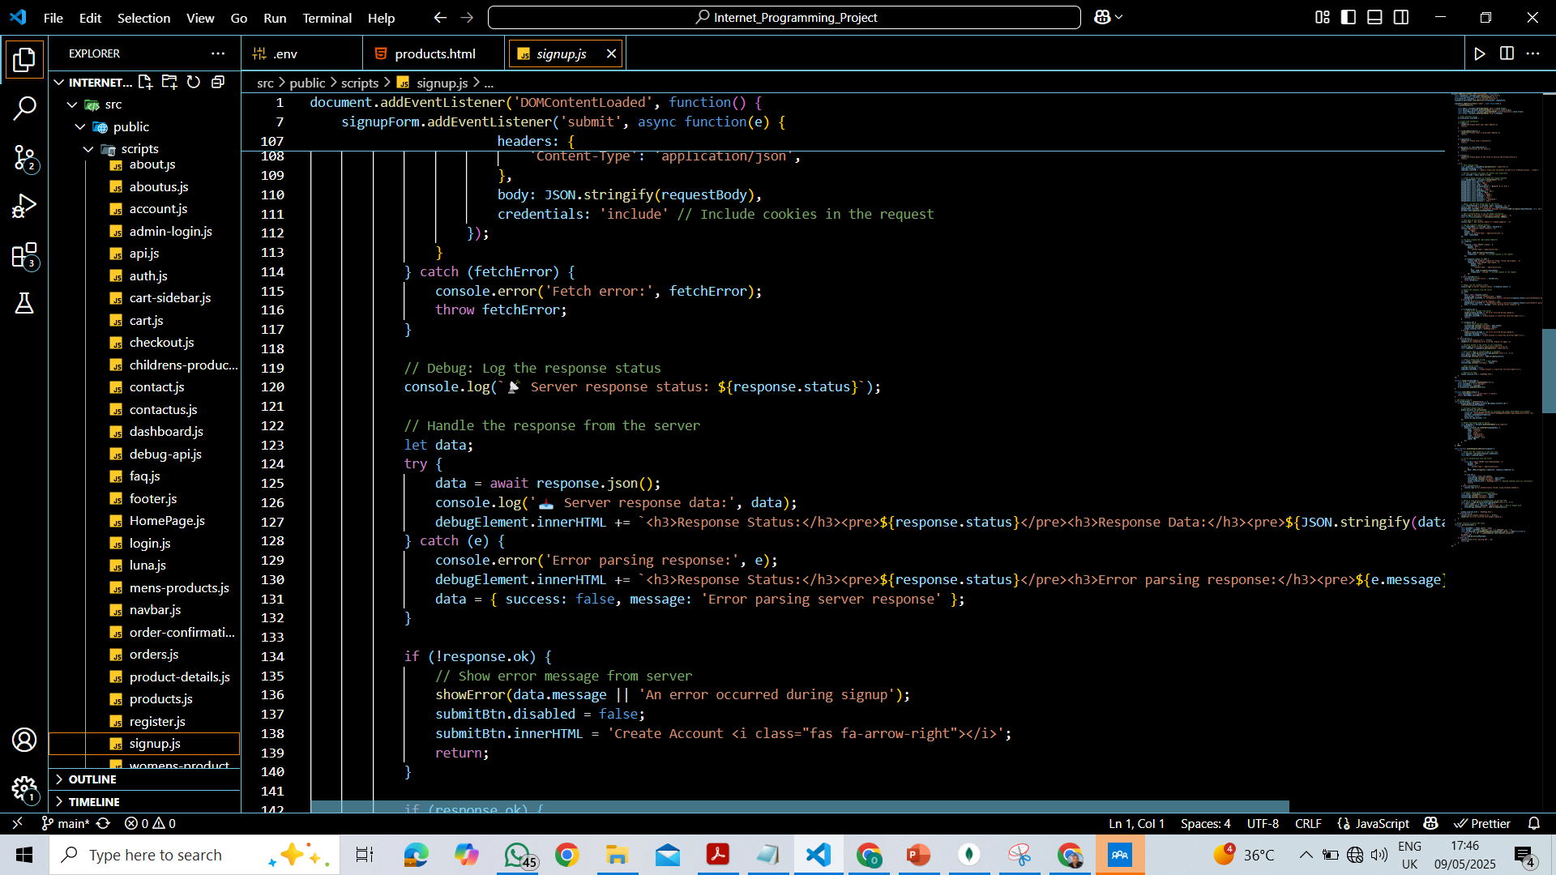
JS for Signup

Slide 13
Topic two
Home page

Slide 14
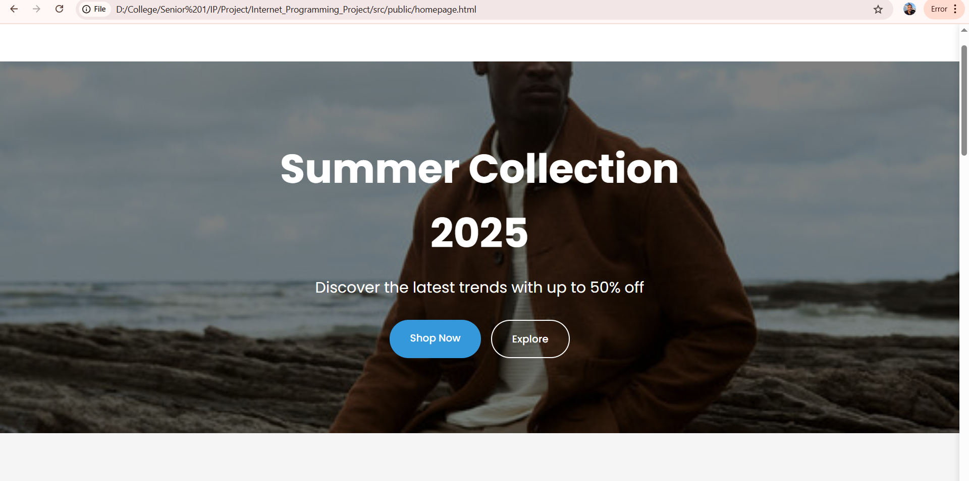
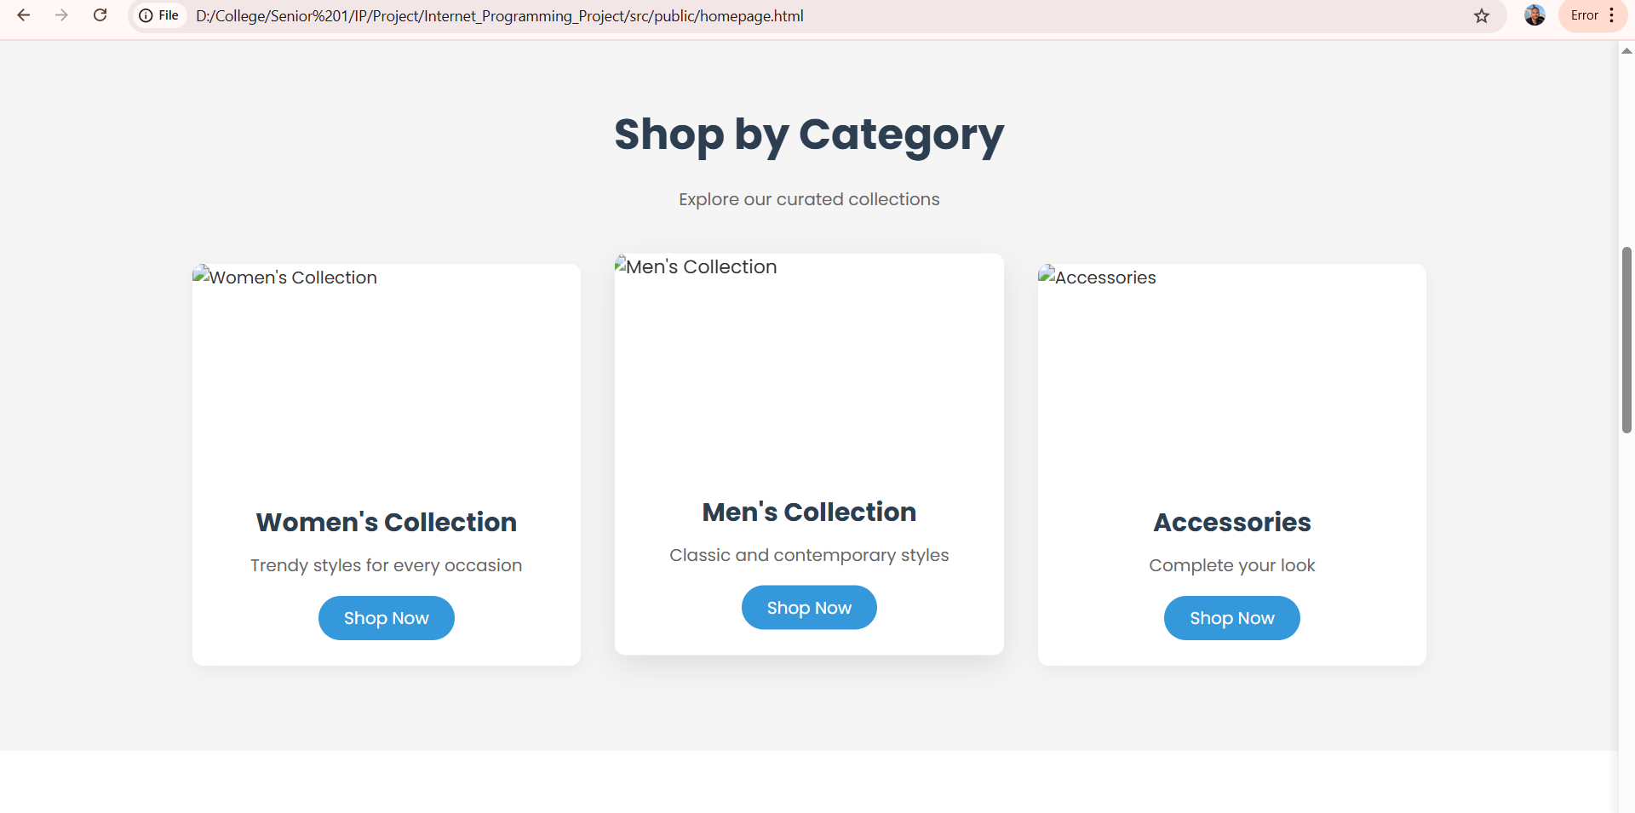
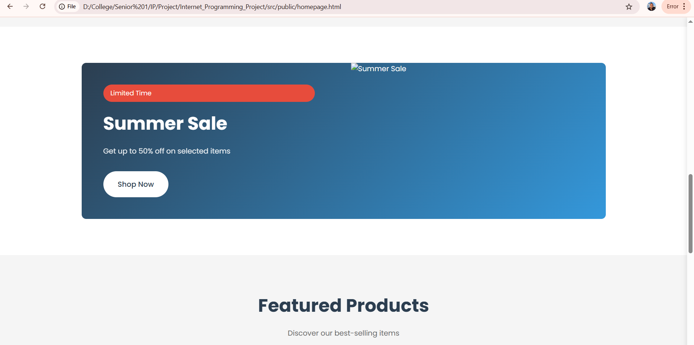
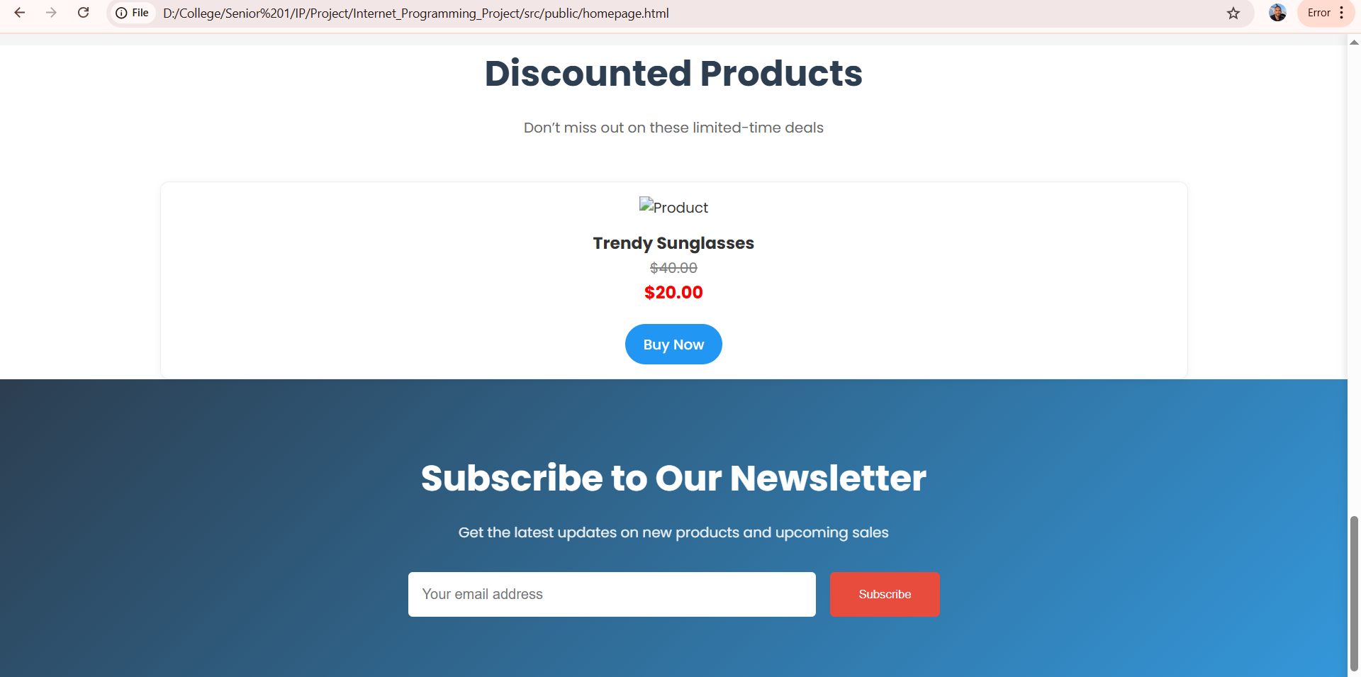
Home Page

Slide 15
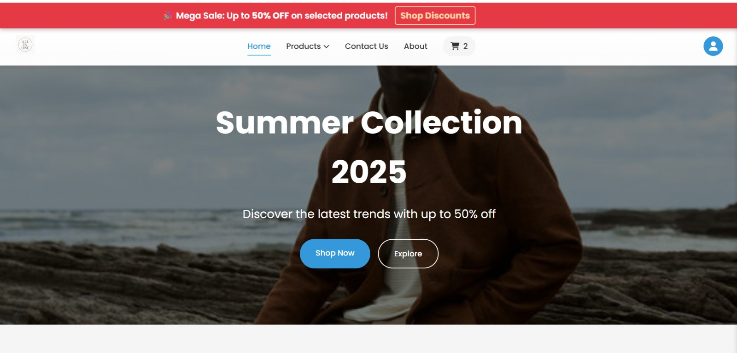

Slide 16
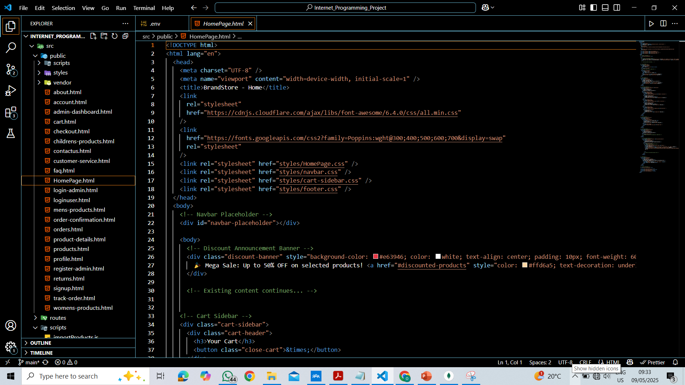
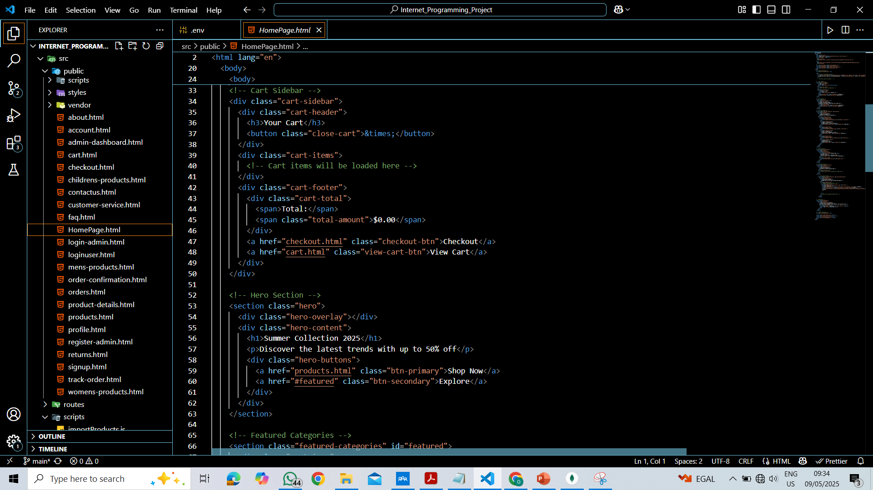
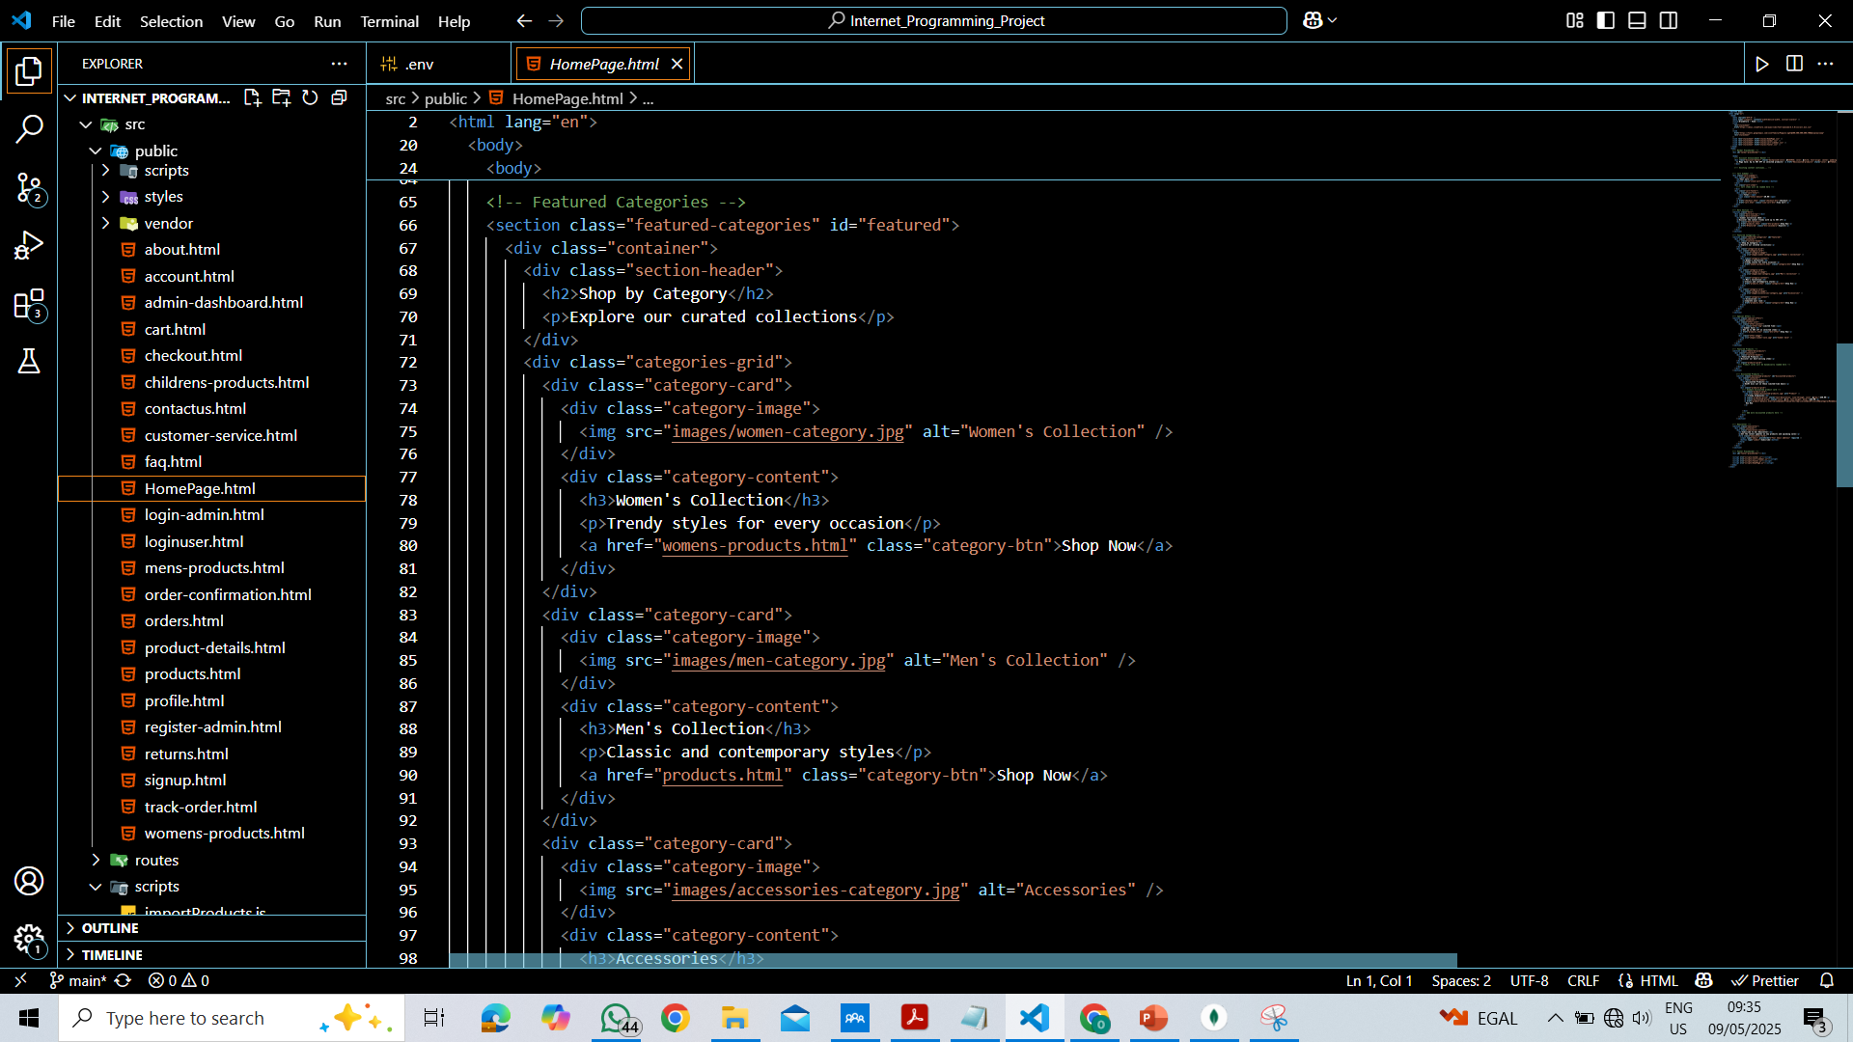
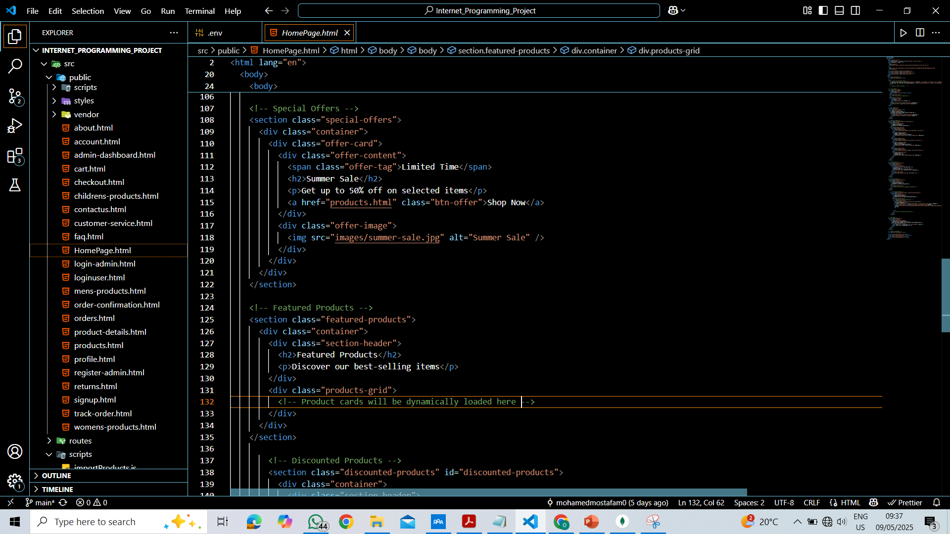
HTML for Home Page

Slide 17
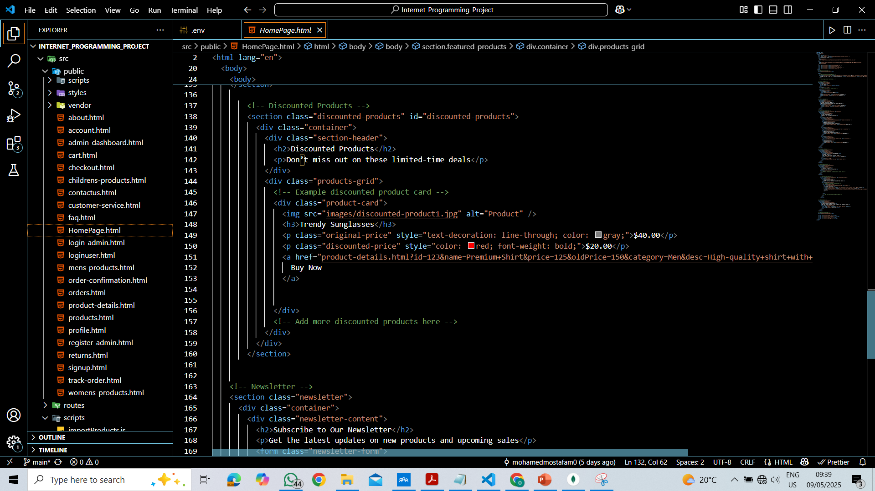
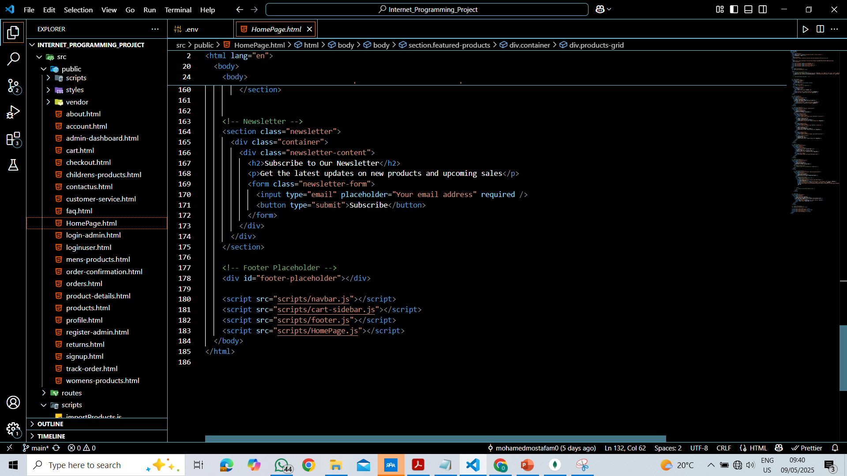

Slide 18
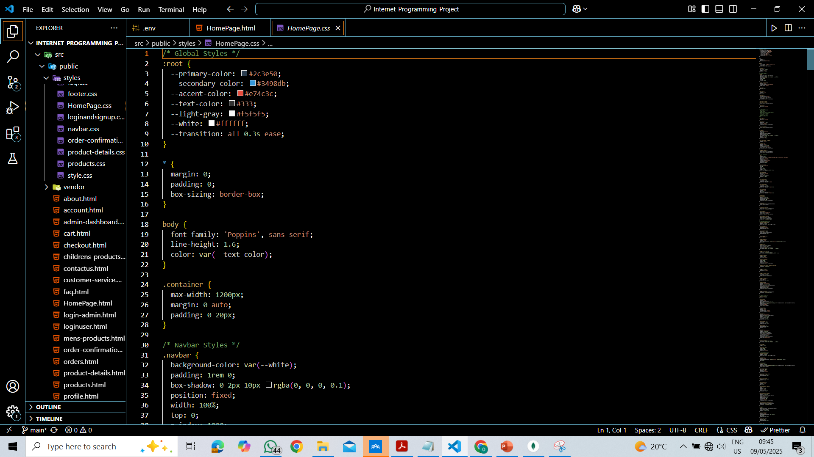
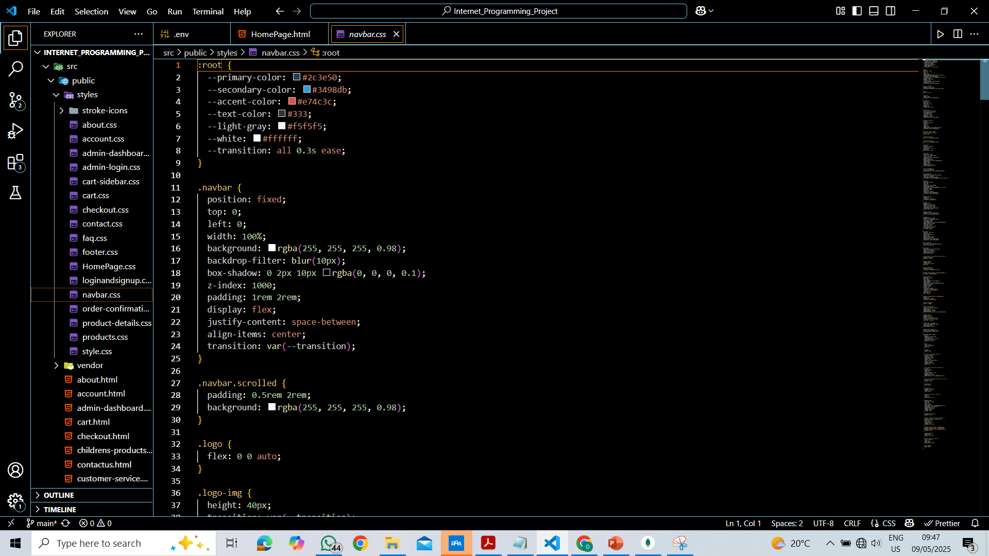
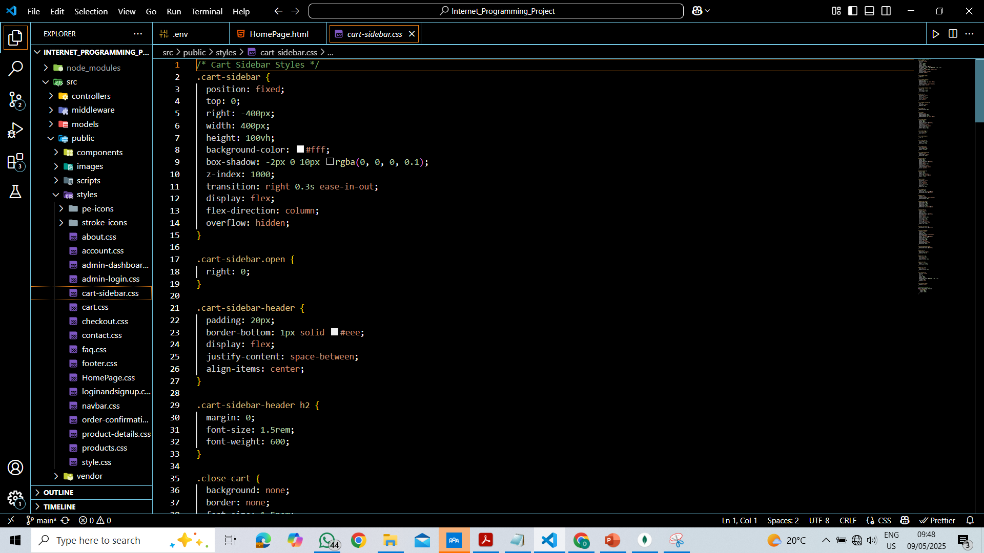
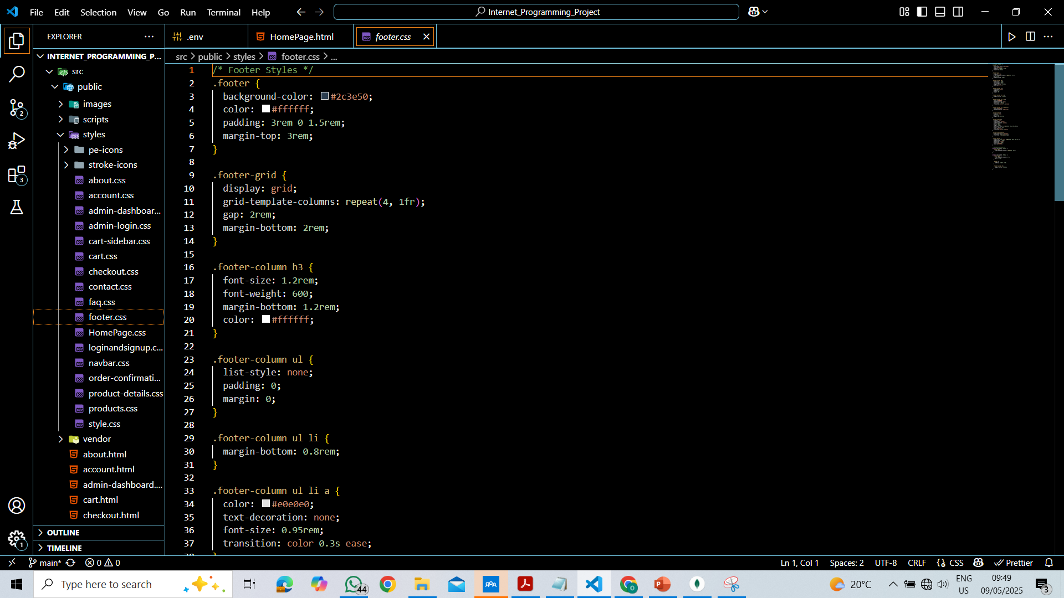
CSS for Home Page

Slide 19
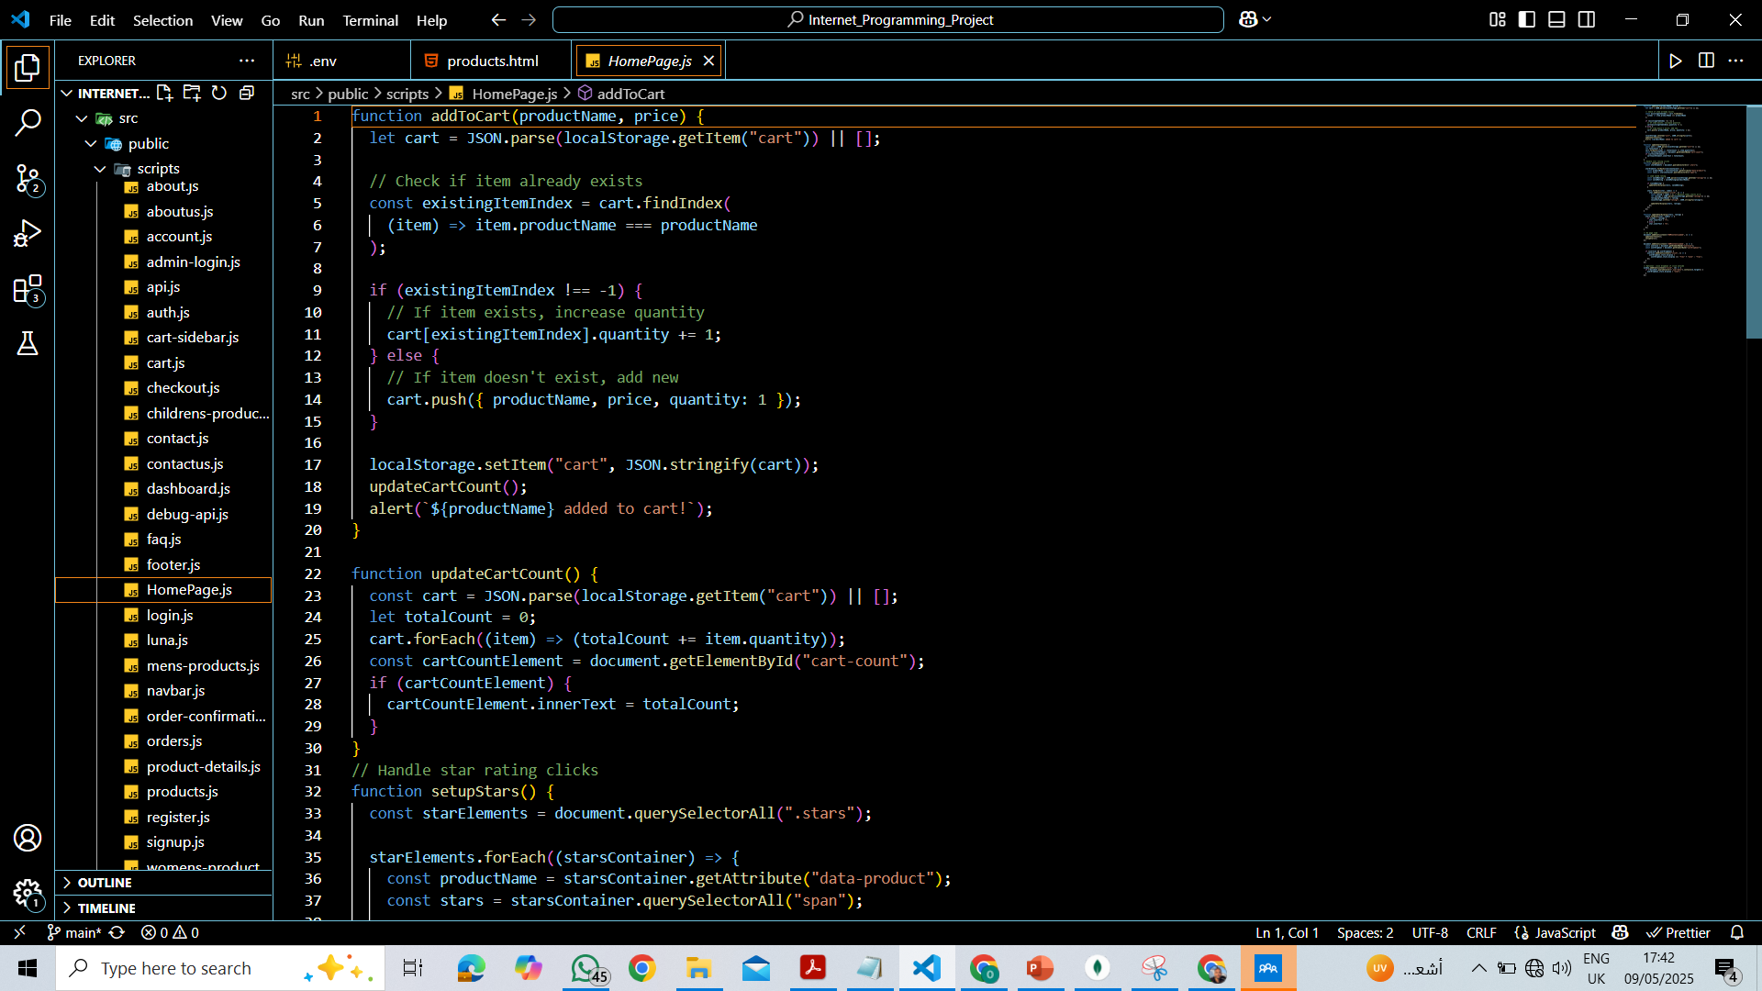
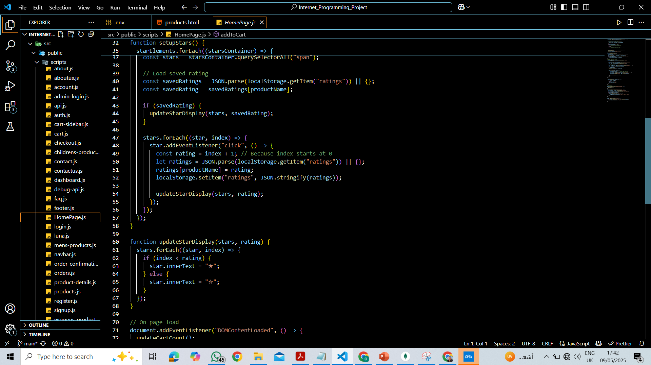
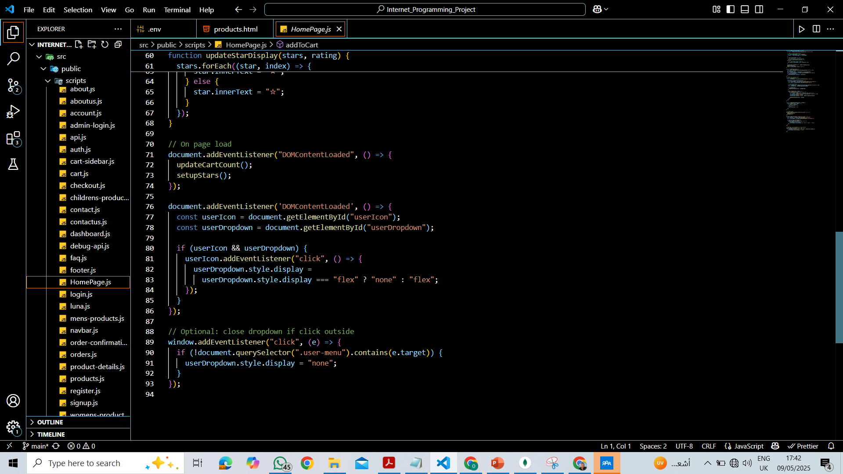
JS for Home Page

Slide 20
Topic Three
Products Page

Slide 21
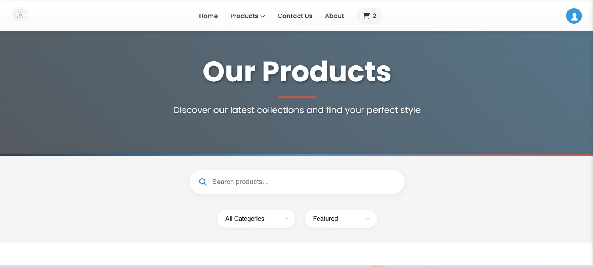

Slide 22
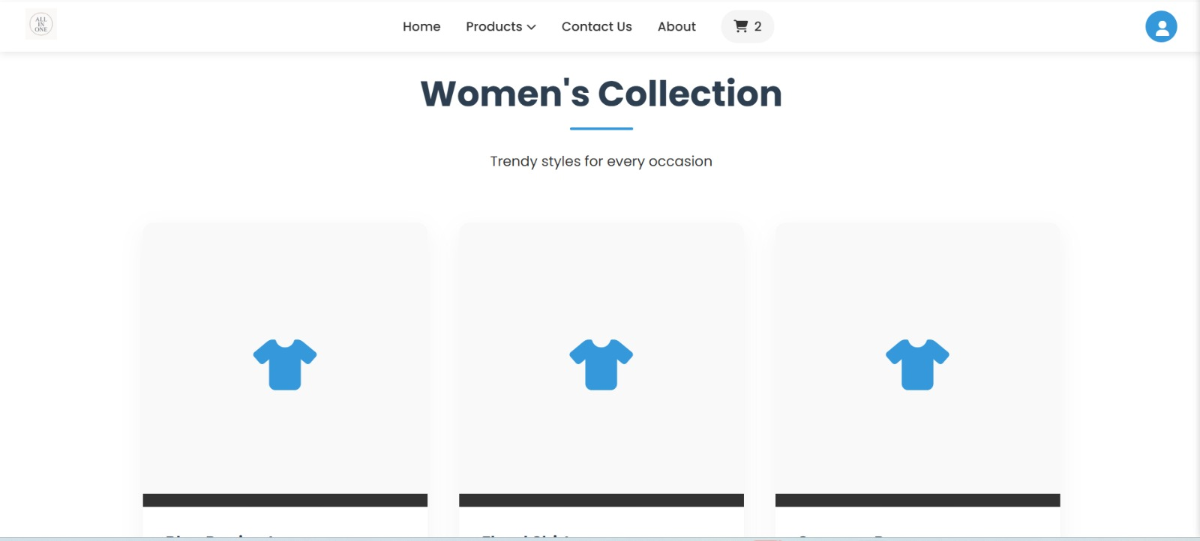

Slide 23
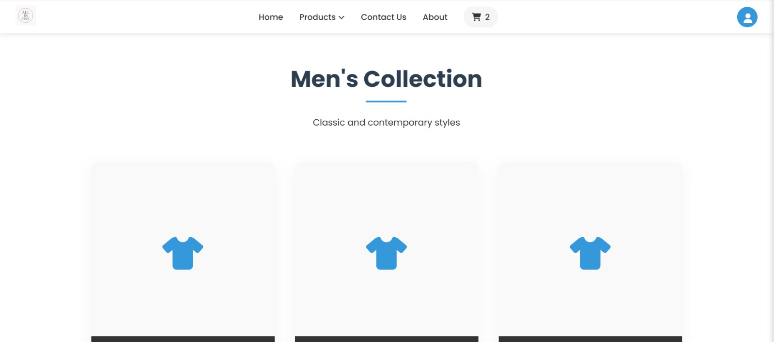

Slide 24
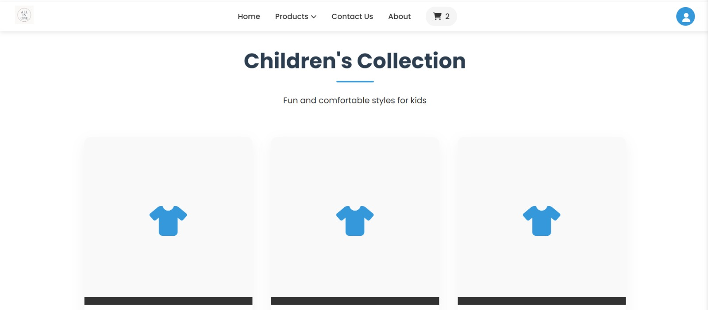

Slide 25
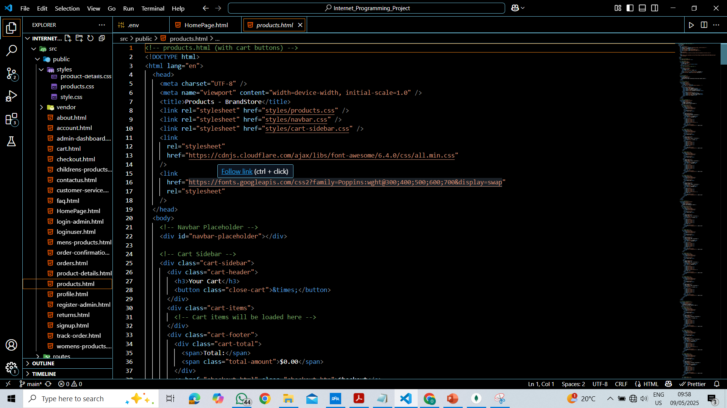
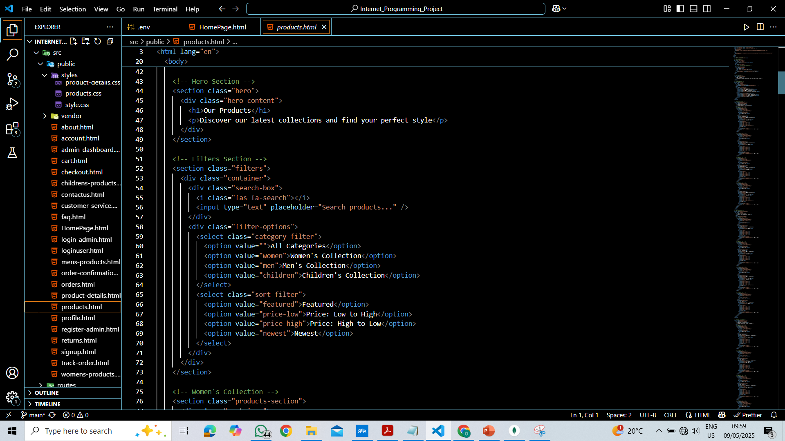
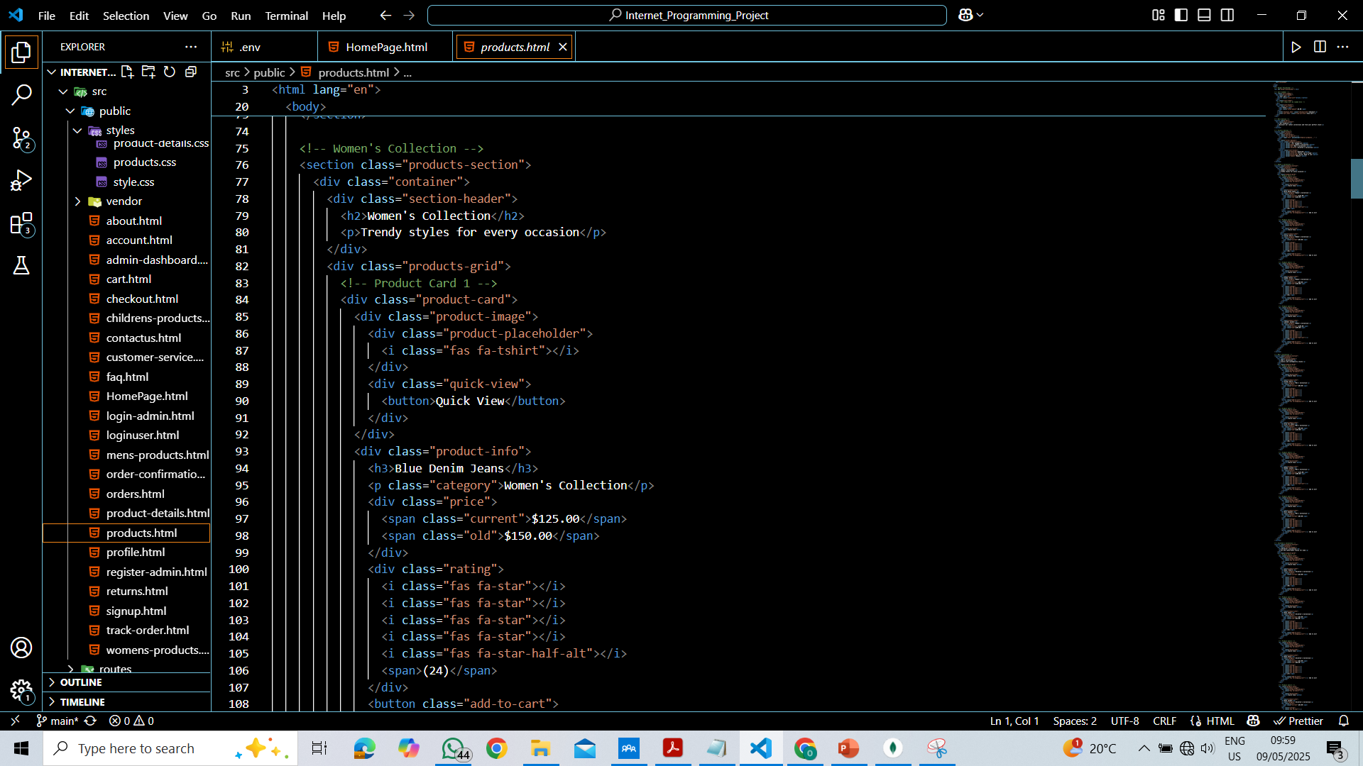

HTML for Products Page

Slide 26



Slide 27



CSS for Product Page

Slide 28




JS for Products page

Slide 29





Slide 30





Slide 31





Slide 32





Slide 33





Slide 34





Slide 35





Slide 36





Html for one of the categories (Men’s Category)

Slide 37



CSS for one of the categories (Men’s Category)

Slide 38



JS for one of the categories (Men’s Category)

Slide 39





Slide 40





Slide 41





Slide 42




HTML for Product Details

Slide 43





Slide 44





Slide 45





Slide 46


CSS for Product Details

Slide 47





Slide 48





Slide 49





Slide 50





Slide 51





Slide 52




JS for Product Details

Slide 53





Slide 54





Slide 55





Slide 56





Slide 57
Topic Four
Cart Page

Slide 58


Slide 59




HTML for Cart

Slide 60






Slide 61




CSS for Cart

Slide 62





Slide 63





Slide 64




JS for Cart page

Slide 65





Slide 66





Slide 67



Slide 68
Topic five
Checkout Page

Slide 69


Slide 70


Slide 71




HTML for Checkout Page

Slide 72





Slide 73



Slide 74




CSS for Checkout

Slide 75





Slide 76





Slide 77





Slide 78




Slide 79




JS for Checkout

Slide 80





Slide 81





Slide 82





Slide 83





Slide 84




Slide 85
Topic six
About us – Contact us – Customer Care

Slide 86


Slide 87


Slide 88


Slide 89


Slide 90


Slide 91


Slide 92


Slide 93


Slide 94


Slide 95


Slide 96


Slide 97




HTML for About Us

Slide 98





Slide 99


Slide 100




CSS for About Us

Slide 101





Slide 102





Slide 103





Slide 104


Slide 105

JS for About Us

Slide 106




HTML for Contact Us

Slide 107





Slide 108




CSS for Contact Us

Slide 109





Slide 110





Slide 111





Slide 112




JS for Contact Us

Slide 113
Topic seven
Product Details

Slide 114


Slide 115


Slide 116
HTML for Product Details

Slide 117
CSS for Product Details

Slide 118
JS for Products page

Slide 119
Topic Eight
Reviews

Slide 120


Slide 121
Topic Nine
Admin Registeration

Slide 122



HTML for Admin Registeration

Slide 123


CSS for Admin Registeration

Slide 124


JS for Products page

Slide 125
Topic Ten
Admin Dashboard

Slide 126



HTML for Admin Dashboard

Slide 127




CSS for Admin Dashboard

Slide 128




JS for Admin Dashboard

Slide 129




Slide 130
Functional & Technical Requirements

Slide 131
Functional Requirements
This section focuses on how the system will serve users. Two specific functions will likely be described in detail. Given the project scope, potential functions could include:
User Registration and Authentication – Enabling users to create accounts and log in securely.
Shopping Cart and Checkout Process – Allowing users to add products to their cart and complete purchases.

Slide 132
Technical Requirements
This section details the tools and technologies needed to build the system, including:
Development Tools – HTML, CSS, JavaScript, and Node.js (with Express.js for backend development).
Frameworks & Libraries – Frontend frameworks like Bootstrap to support responsive design.
APIs for Integration – Authentication API – OAuth-based login systems (Google, Facebook) allow users to sign in without creating separate accounts.Product Information API – If pulling product details from external suppliers, APIs can sync inventory and prices.Tax Calculation API – Determines correct tax rates based on the user's location and applicable regulations. .GET and .POST methods will work within these APIs.

Slide 133




Thank you

